Slide 1
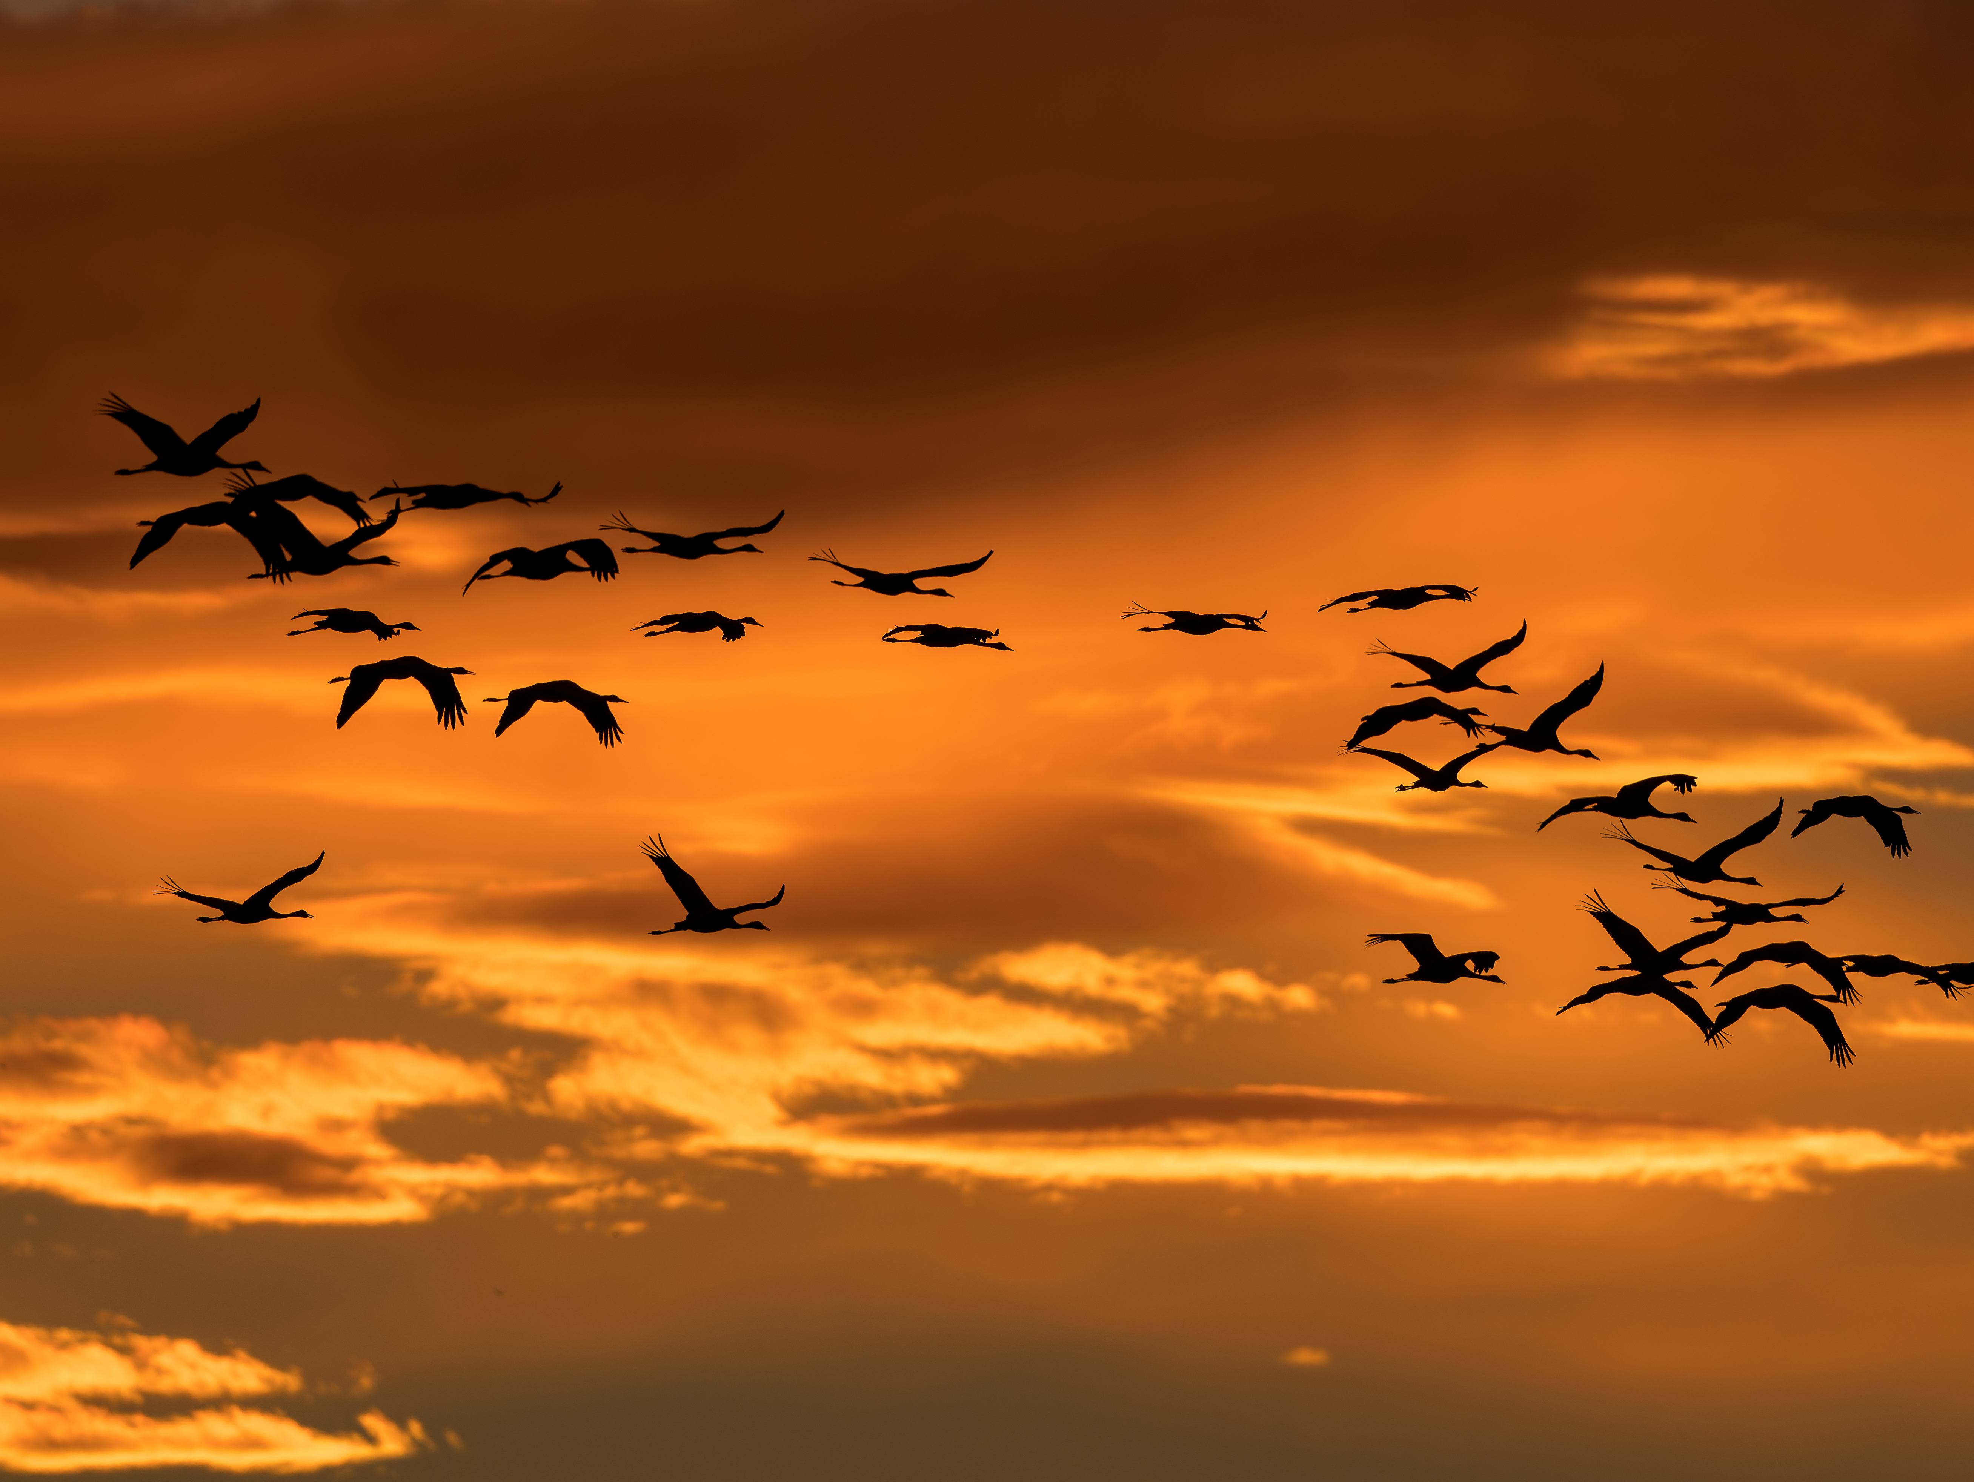
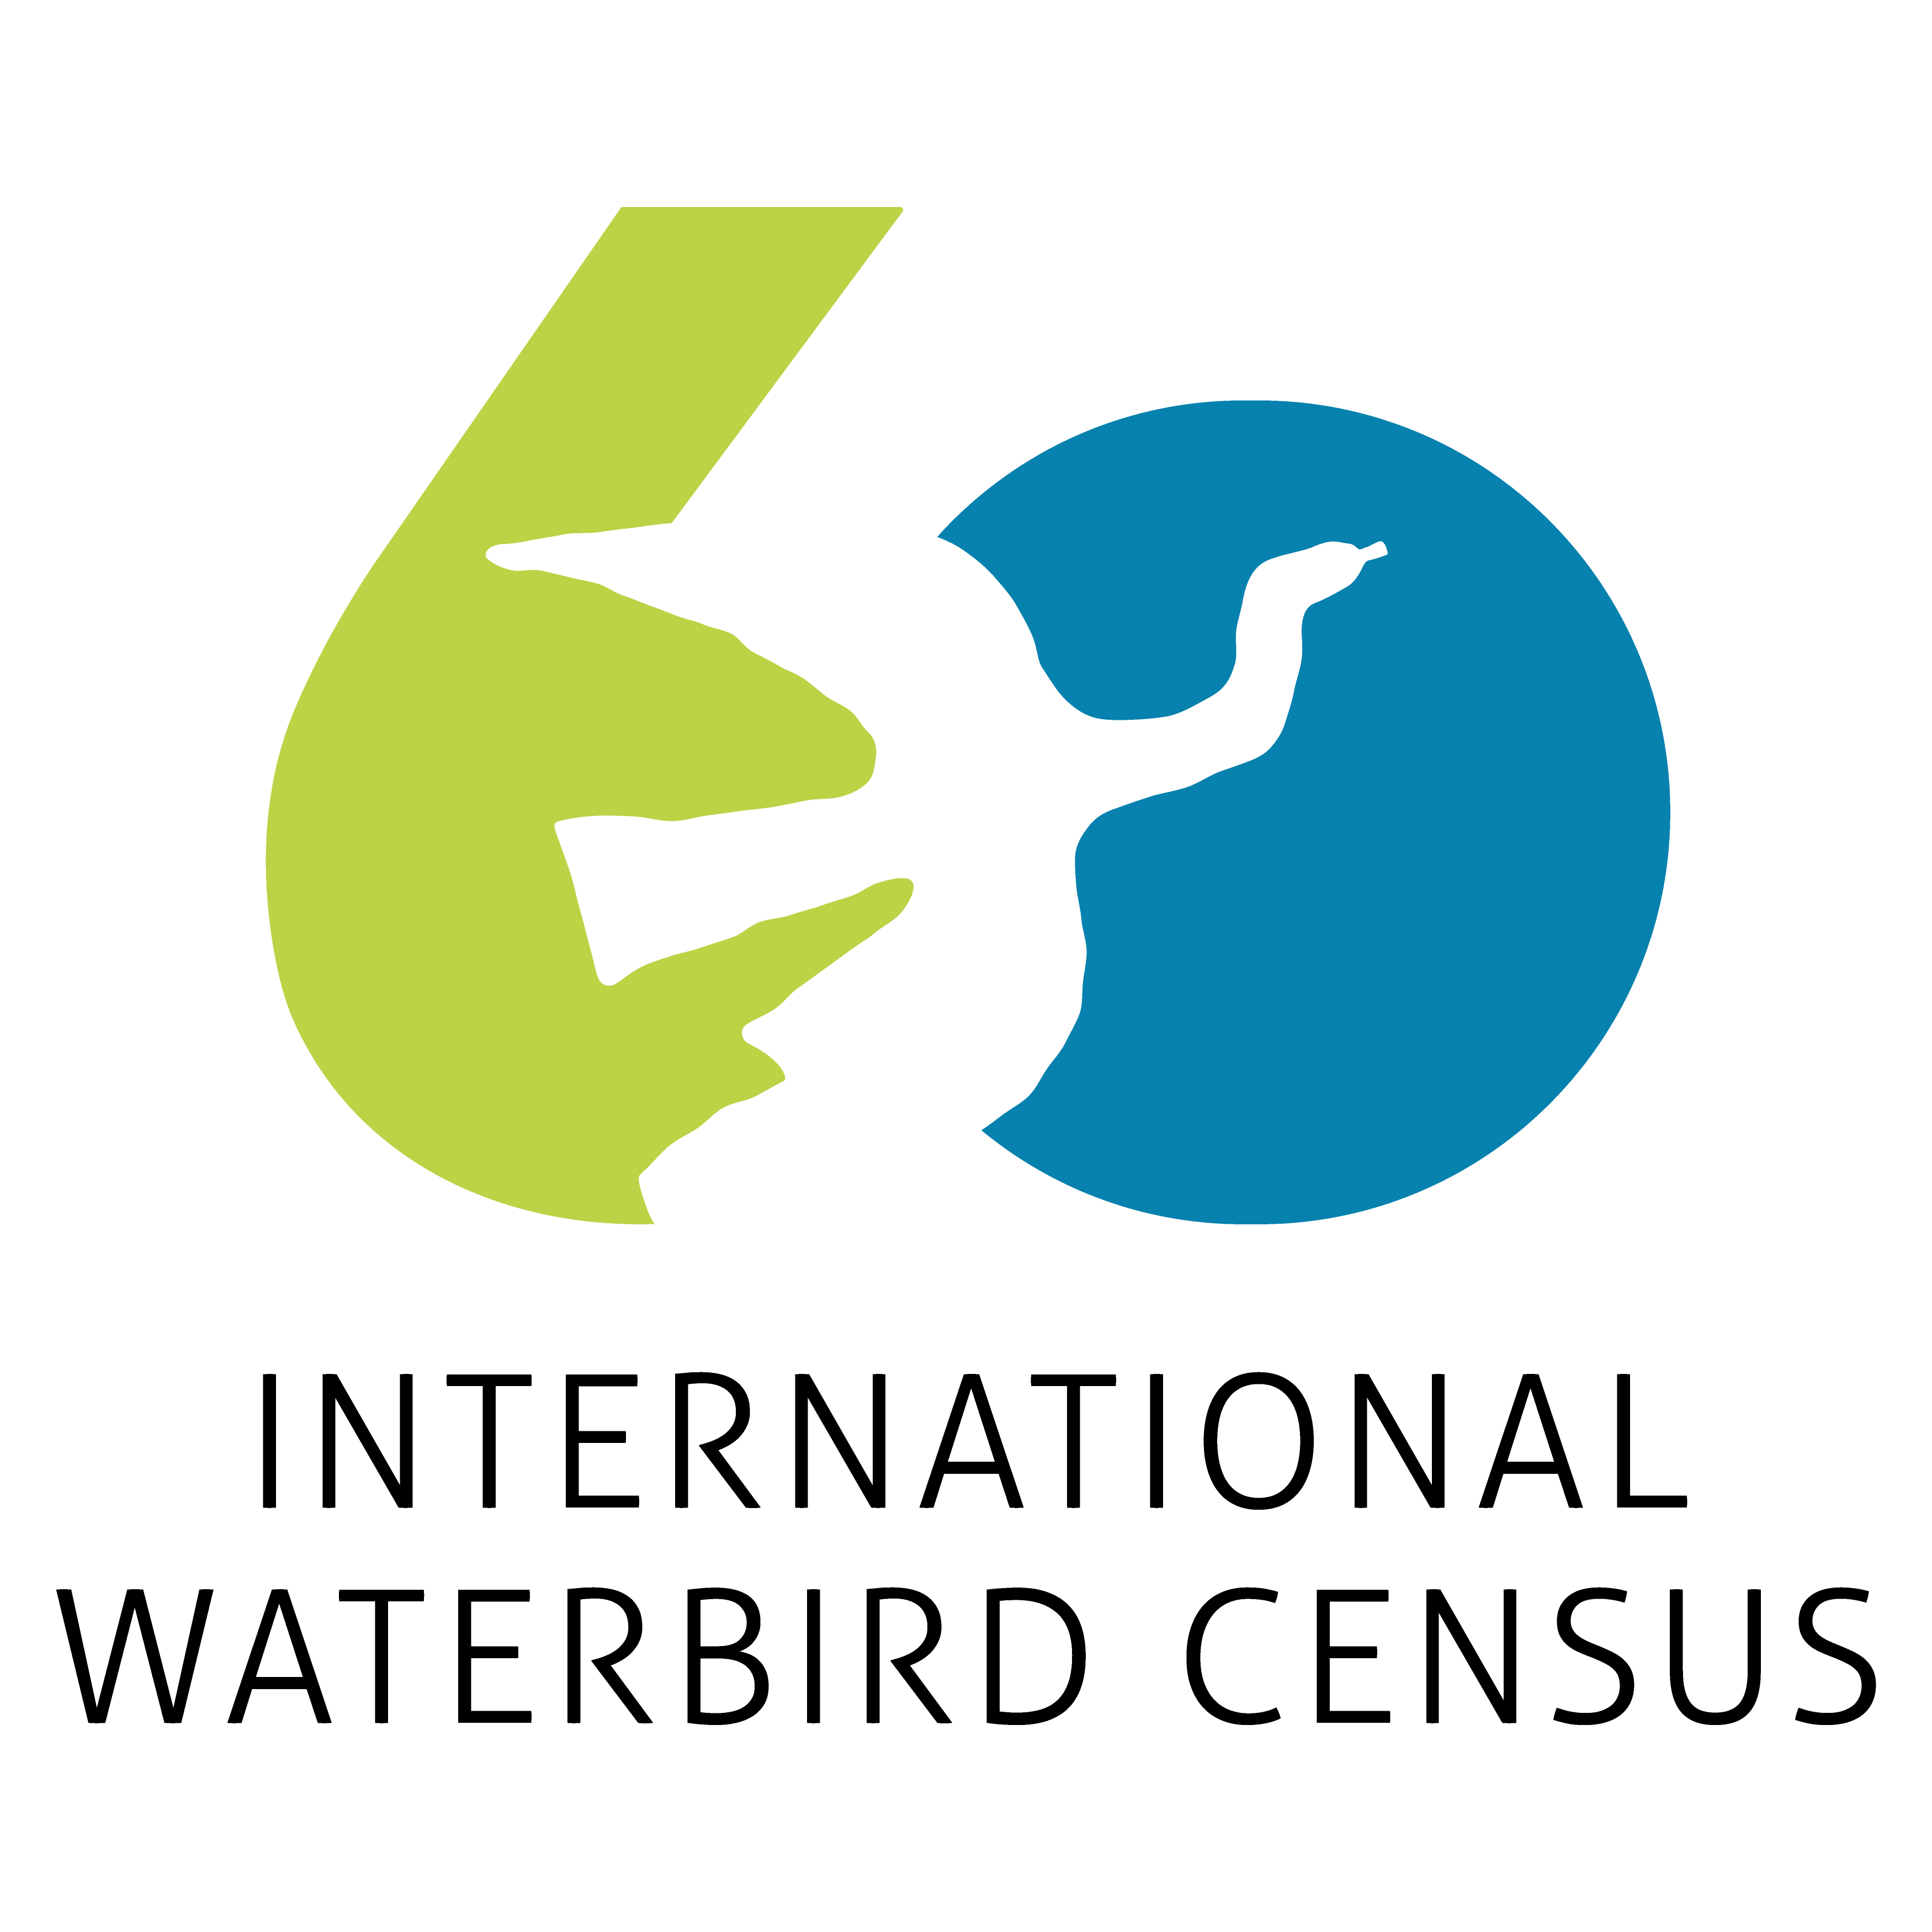
Counting for Conservation:
Celebrating the 60th edition of the International Waterbird Census
A global effort to monitor and protect waterbirds and wetlands since 1967
Luca Guitink
Luca.Guitink@wetlands.org
© Sergey Dereliev, www.dereliev-photography.com
Notes:
Today I’d like to talk about one of the most remarkable citizen science programmes in the world: the International Waterbird Census.
This coming January, the IWC will celebrate something quite special - its 60th anniversary — six decades of people around the globe coming together to count waterbirds. Tens of thousands of volunteers, in all kinds of wetlands, have contributed to this shared effort.
It’s not just about numbers: this is one of the longest-running biodiversity monitoring programmes in existence. Thanks to it, we can see how waterbird populations are changing, and what that means for the wetlands they depend on.
Throughout this presentation, explain how the IWC60 connects directly to WI’s new 2025 – 2035 strategy, and the role of WI in the census.

Slide 2
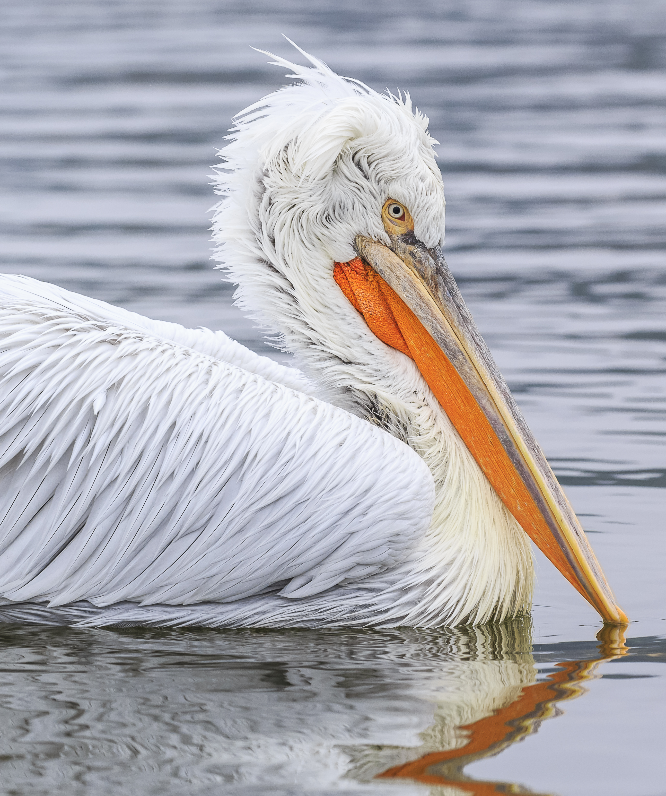
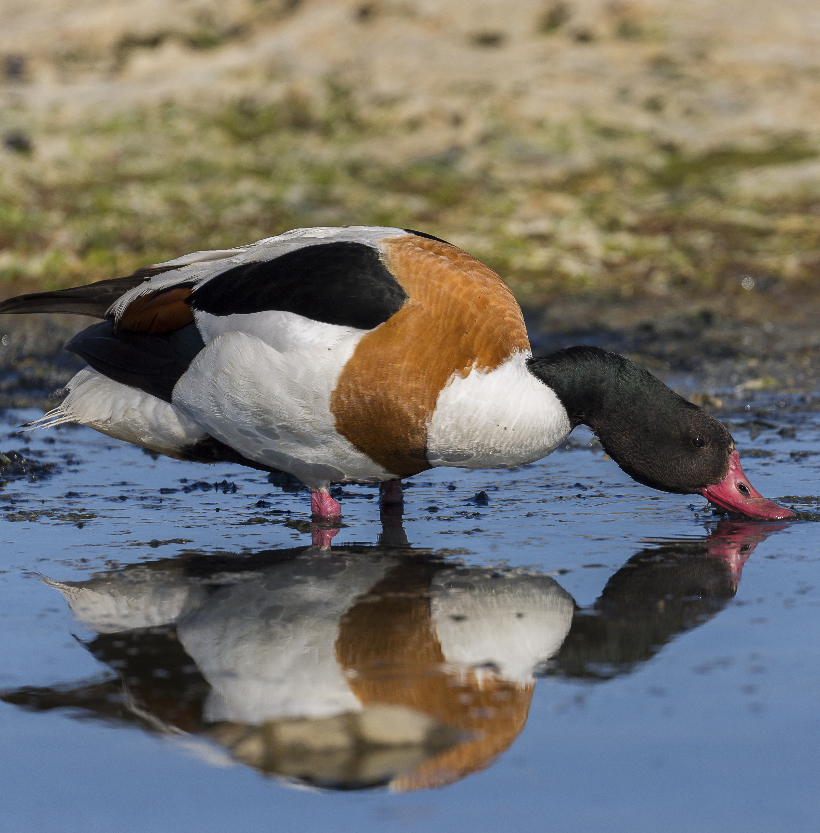
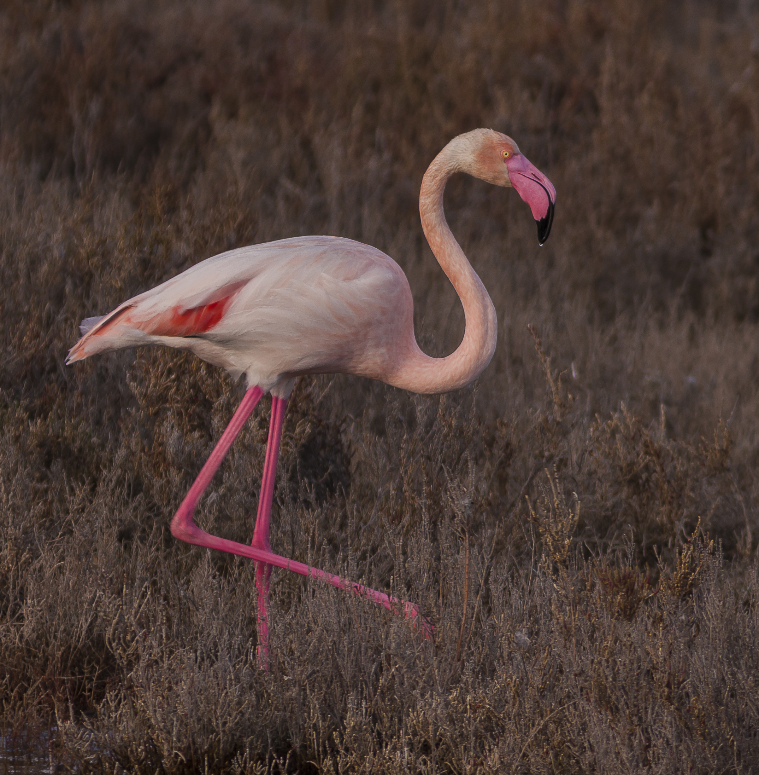
A Living Legacy
From 1967 to today: one of the world’s most important conservation tools.
Legacy: documenting recovery, supporting Ramsar & Red List, providing evidence to governments.
Powered by tens of thousands of volunteers and coordinators.
A story of collaboration and commitment to wetlands and waterbirds.
© Sergey Dereliev, www.dereliev-photography.com
Notes:
From its beginning in 1967, the IWC has become one of the most important conservation tools in the world. Its legacy includes documenting recoveries, supporting Ramsar designations, and providing data for the Red List. It also provides politicians and site managers with the evidence needed for decision-making. Above all, it is powered by people: tens of thousands of volunteers, observers, and national coordinators.
Beyond the science, the IWC is a story of community, collaboration, and commitment to waterbirds and wetlands.

Slide 3
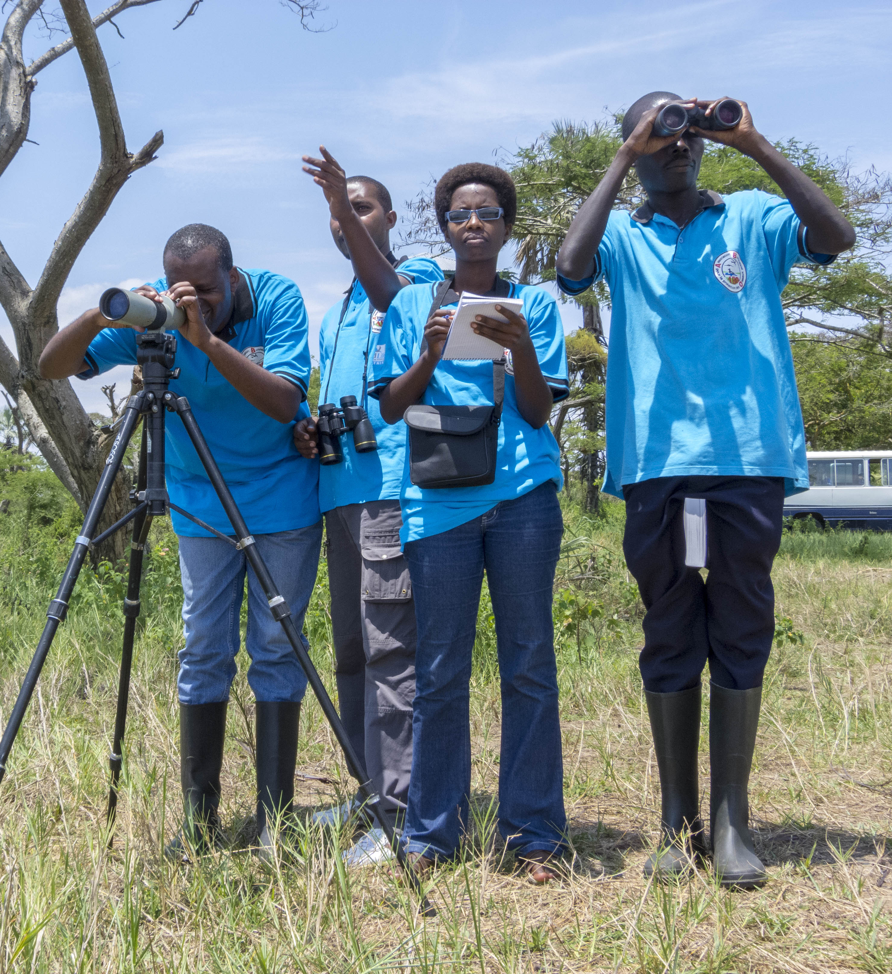
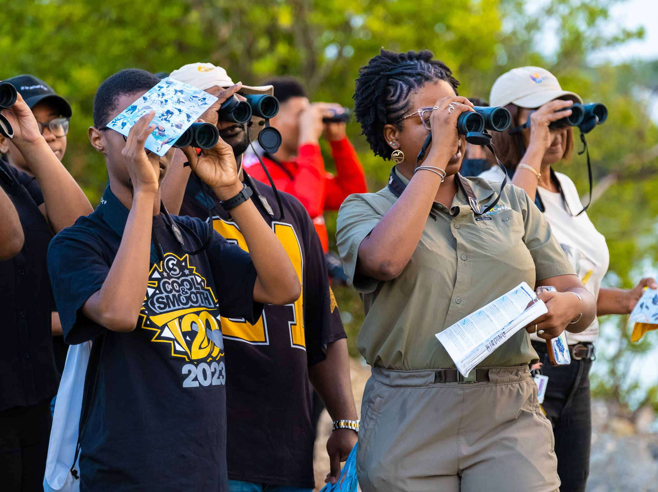
Why Count Waterbirds?
Photo by BirdsCaribbean
Photo by Szabolcs Nagy
Highly visible, relatively easy to count
Hunted species – sustainable management needs collaboration
Birdwatchers & volunteers support the census
Annual counts reveal site, national, population trends
Trends inform conservation policy & management
Notes:
Why do we count waterbirds? Waterbirds are highly visible, and occur across a wide range of wetlands worldwide. Waterbirds are also a popular hunted species attracting millions of hunters worldwide. At the beginning of the 20th century, It was recognised that the only way to conserve and sustainably manage waterbirds was through international collaboration. Luckily, waterbirds fascinate amateur birdwatchers and are also relatively easy to count. That makes them attractive and cost effective to count year after year with a largely volunteer network, allowing us to track population trends over time, for a whole population, nationally and at site level.
Beyond the science, the IWC is also a movement – it connects communities across continents, in line with WI’s ambition to build a global movement for wetlands.

Slide 4
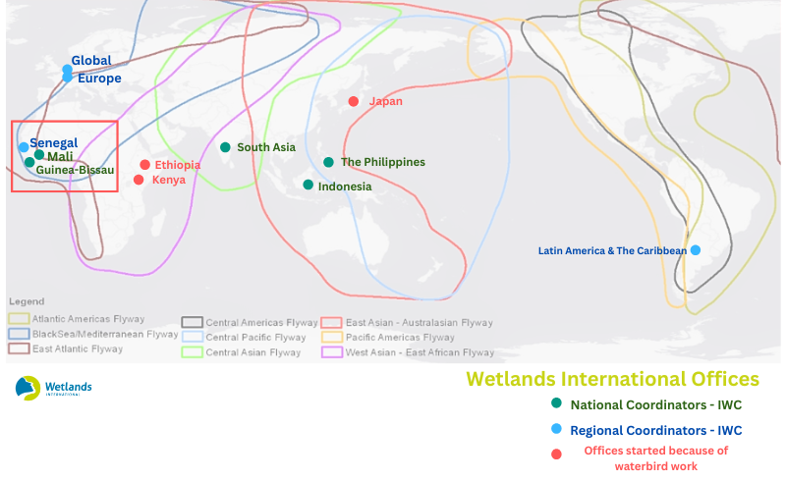
The Flyways & IWC Coordinators
Flyways: The complete annual migration routes linking breeding, staging, and non-breeding sites across countries and continents.
IWC Coordinators across the flyways
IWC best model for scaling up
Global program
Allows WI to go to many countries & engage with local stakeholders
Many WI offices began thanks to waterbird work (IWC)
Notes:
As we know, many waterbirds migrate thousands of kilometers every year along what we call flyways – migratory routes that connect breeding, stopover, and wintering sites across countries and continents.
The IWC relies on a network of national and regional coordinators across these flyways who organise counts, support volunteers, and ensure data quality.
The IWC is also a very good model for WI’s new strategic intent of scaling up – it is a global program, that allows WI to go to many countries and engage with local stakeholders. Many WI offices began thanks to waterbird work.

Slide 5
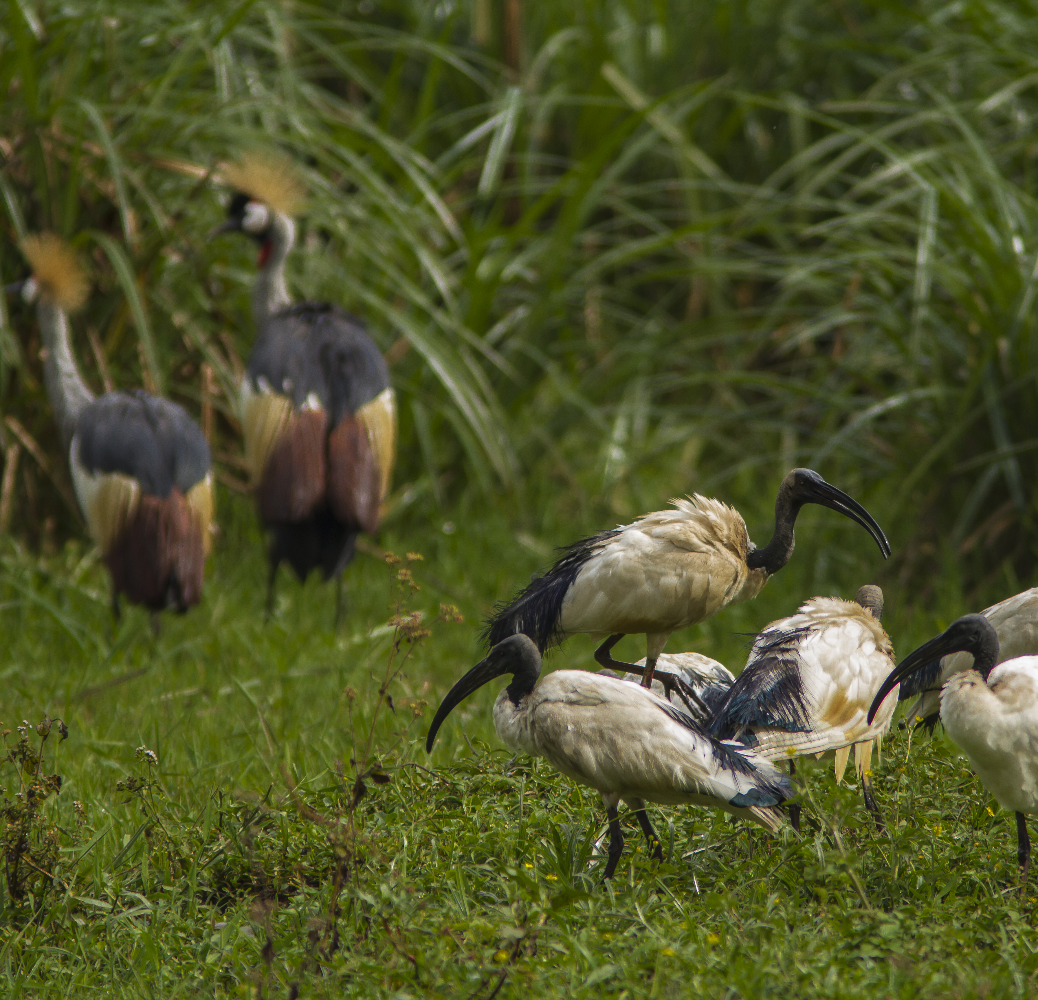
IWC & WI’s Strategy (2025–2035)
Waterbirds = indicators of wetland productivity
Flyway-based approach = directly supports WI’s 10 flagship wetland landscapes
Monitoring = IWC provides evidence base for adaptive management. Very (cost) effective
People & networks = IWC builds capacity and connects communities globally
© Sergey Dereliev, www.dereliev-photography.com
Notes:
The IWC could provide support to the new Wetlands International Strategy in various ways. Waterbirds could be included in projects as indicators of wetland productivity, the flyway-based approach of the IWC directly supports WI’s 10 flagship landscapes, MONITORING - the IWC provides evidence base for adaptive management, MONITORING INDICATOR FOR PROJECTS – effective + cost effective, and the IWC is well established as a model for capacity building, connecting communities globally.

Slide 6
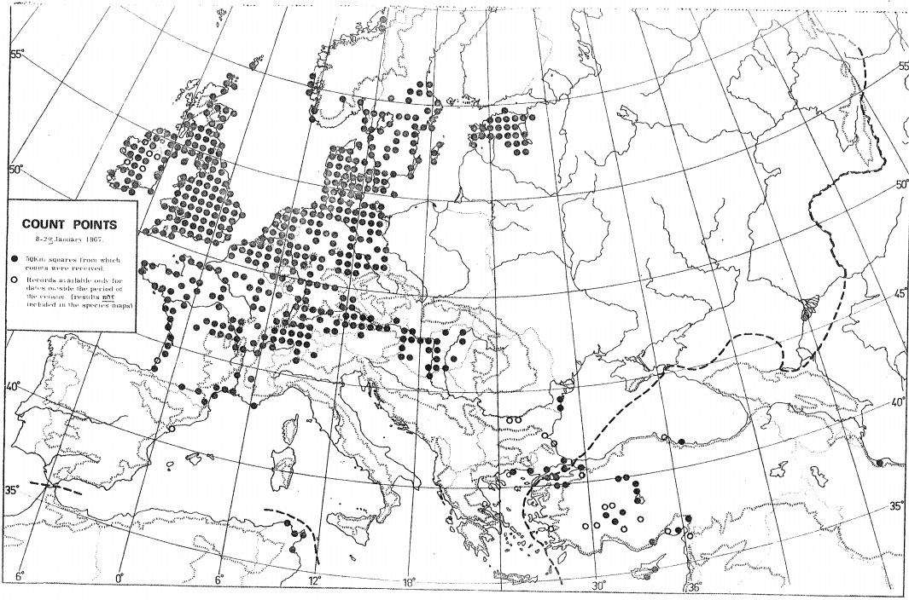
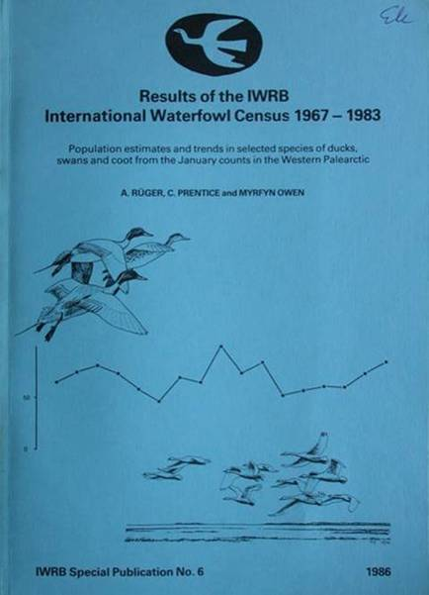
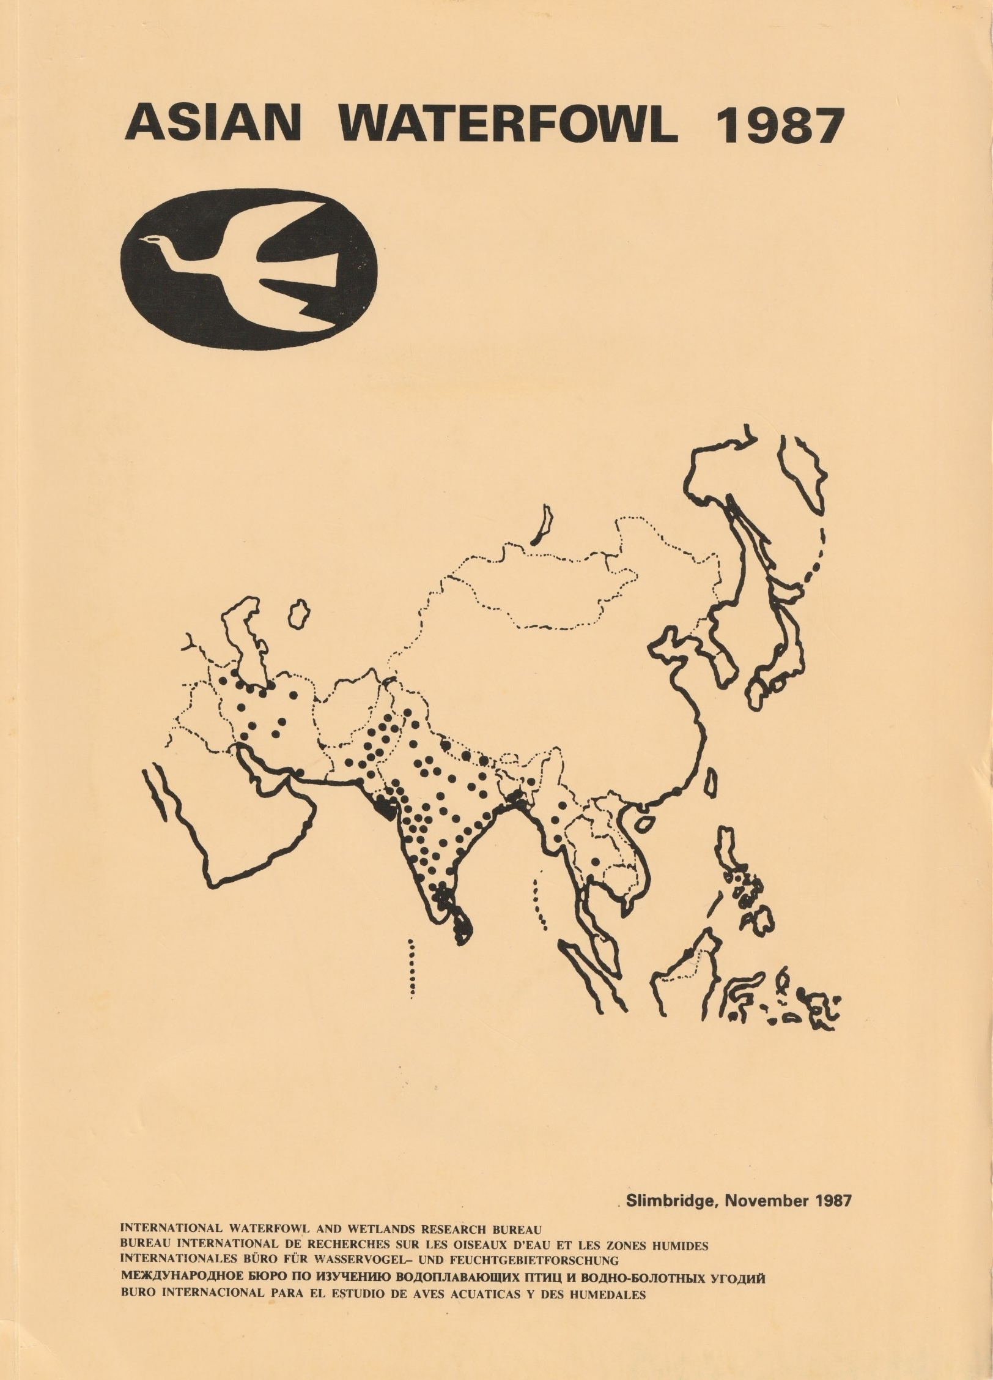
The Beginning
1967
First IWC across Europe & Western Palearctic, led by IWRB (predecessor of Wetlands International).
Built on UK counts since 1947 (post-war)
Initially focused on hunted species: geese, ducks, coots
1973
By 1973: 40,000+ counts from 55 countries and 13,000 wetlands.
Now
189 countries, 67,000 sites, 1.9 billion birds recorded.
Citizen science: driven by tens of thousands of volunteers
Value in continuity over time & standardized methodological approach – long term dataset
Notes:
So, let's dive a bit into the history. The IWC began in 1967 with counts across Europe and the Western Palearctic, - coordinated by the International Waterfowl and Research Bureau (IWRB). This built on earlier efforts in Britain, which began just after World War II in 1947.
1st activity + focus of IWRB = IWC. Realisation – many waterbirds are dispersed and hidden in the breeding season but congregate in large flocks at fewer sites during the northern winter.
At that time the aim was to understand international changes in important hunted species like geese, ducks and coots, many of which had shown alarming local declines as wetlands disappeared from the landscape. These early efforts provided the first reliable ‘snapshot’ of northern European wintering populations.
Since then, the IWC has expanded to 189 countries and territories, with over 67,000 sites surveyed. More than 1.9 billion waterbirds have been recorded in the dataset
The real value of the IWC lies in its continuity over time and its standardised methodological approach – year after year, the same counting effort has built a reliable long-term dataset that guides our work to conserve waterbirds and wetlands.

Slide 7

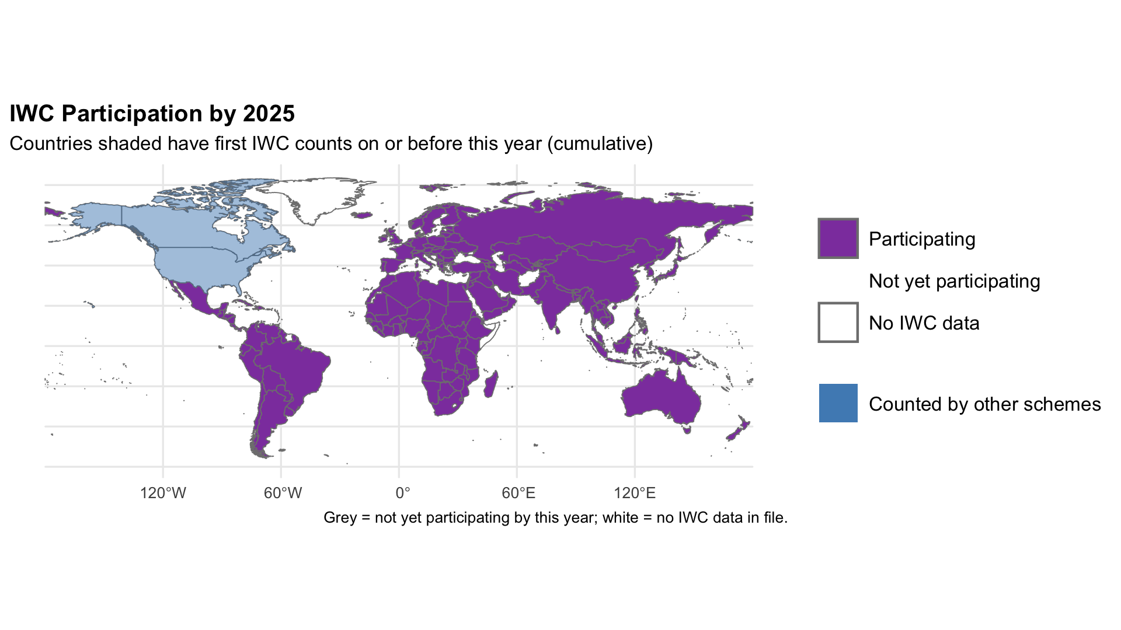
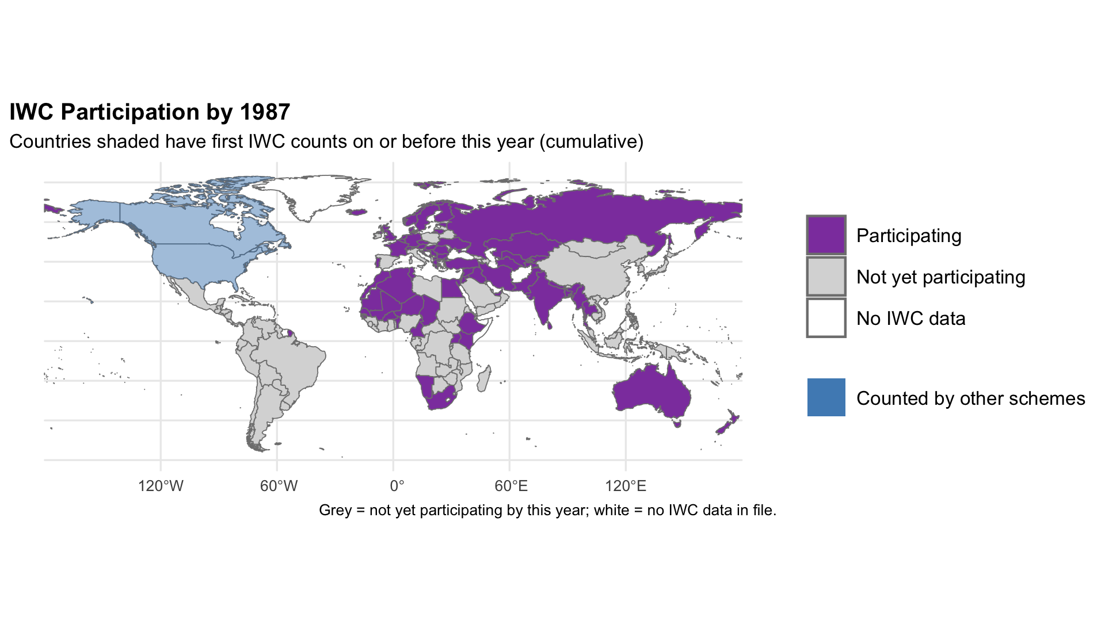
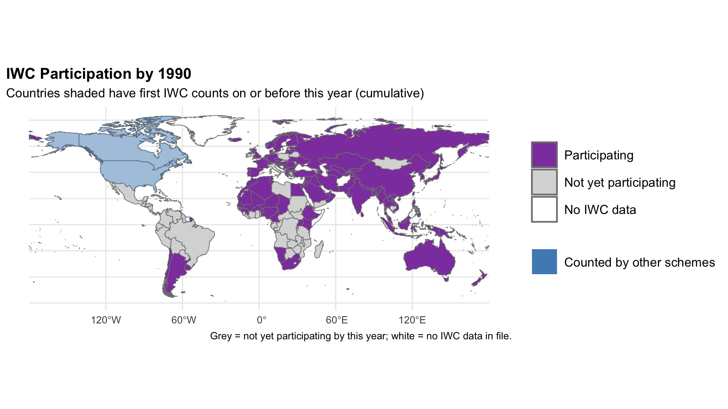
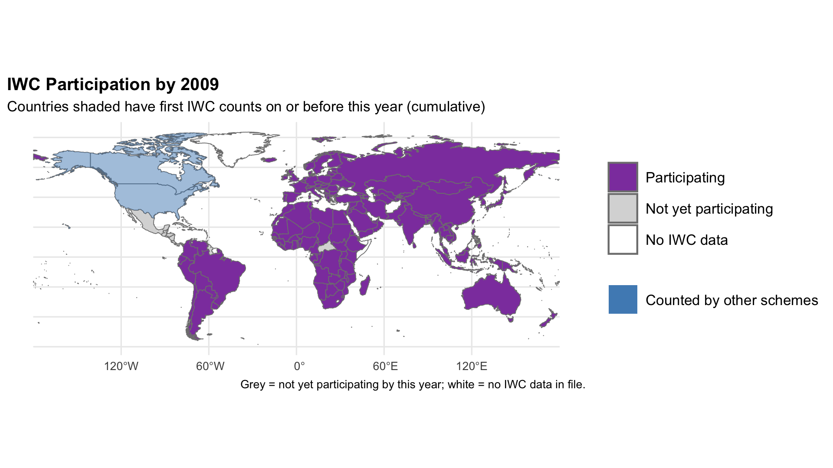
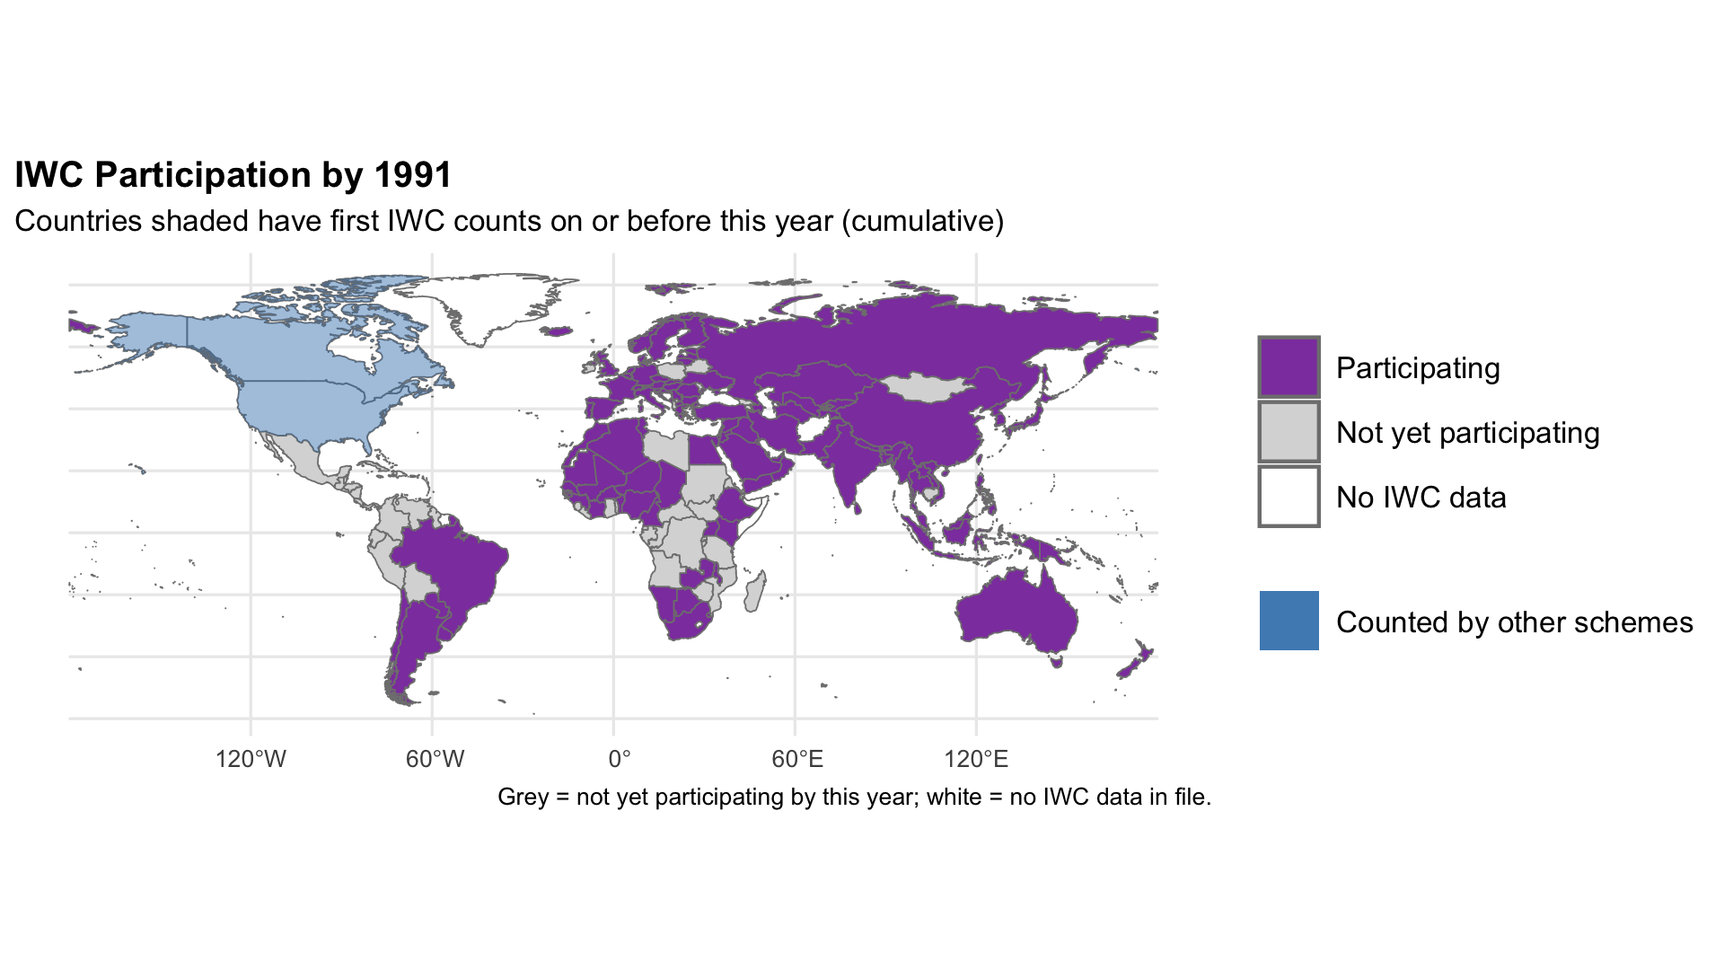
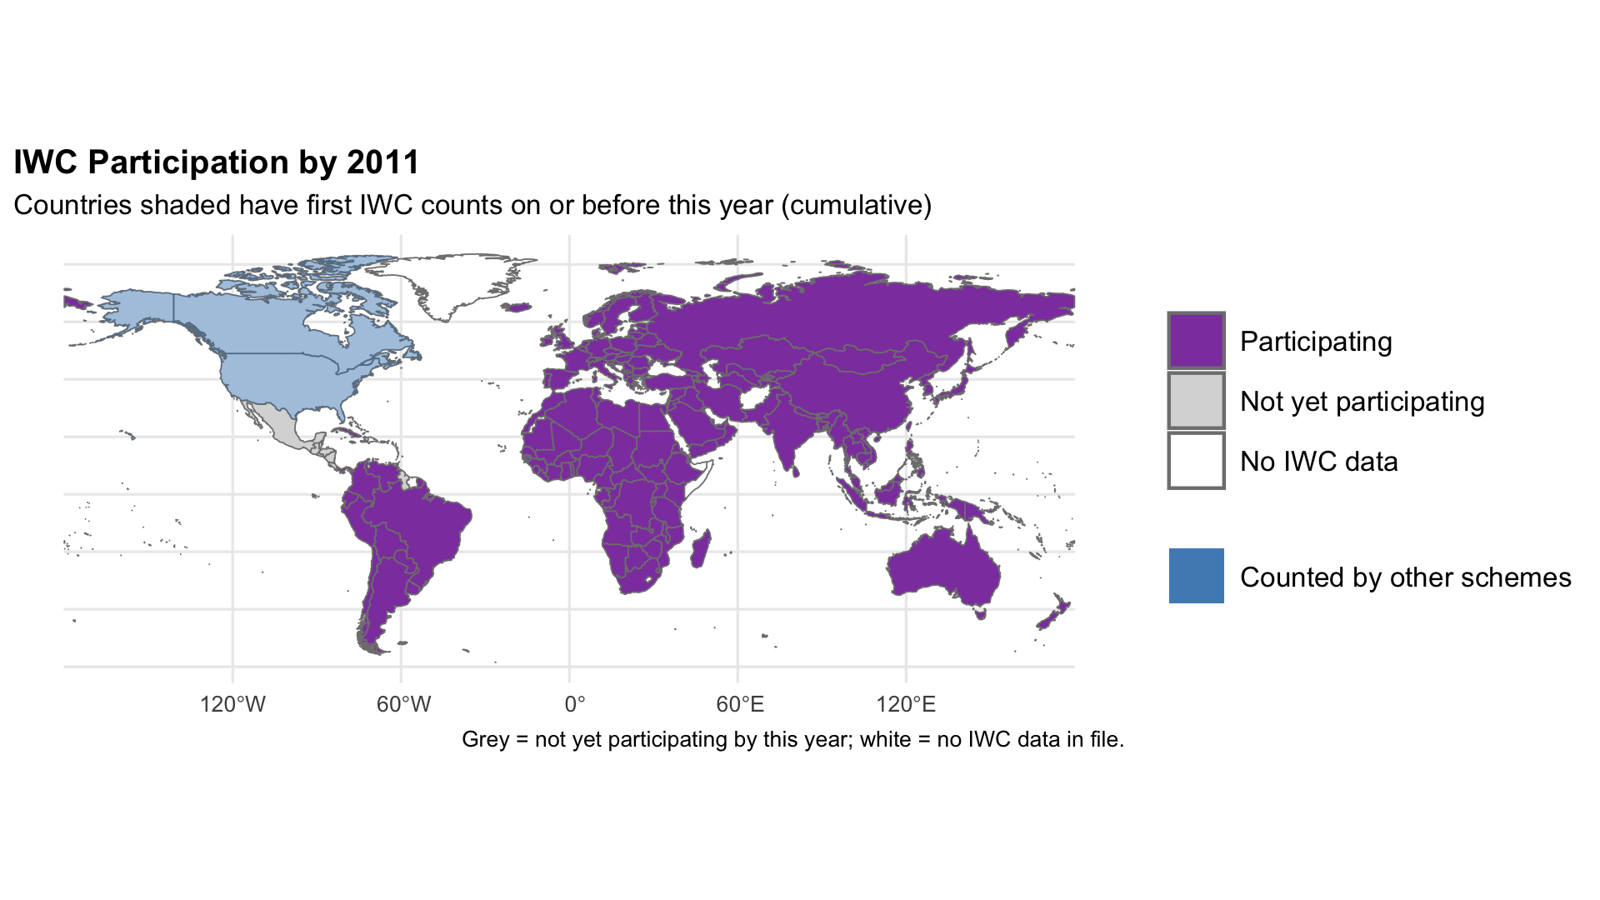
Global Expansion
1987 – Asian Waterbird Census: AWC40 this year
1990 – Neotropical Waterbird Census
1991 – African Waterbird Census
2009 – Caribbean Waterbird Census.
2011 – Central American Waterbird Census
Notes:
The Western Palearctic effort encouraged similar monitoring schemes around the world.
In Asia, Asian Waterbird Census or AWC - 1987
Neotropical waterbird census or NWC – 1990 .
African Waterbird Census or AfWC - 1991.
More recently, sister schemes were initiated in the Caribbean in 2009, coordinated by BirdsCaribbean, and Central America in 2011 by Manomet and the Western Hemisphere Shorebird Reserve Network
This growth has been driven by Wetlands International and its partners — making the IWC a truly global programme that reflects our mission of connecting wetlands and people worldwide.

Slide 8
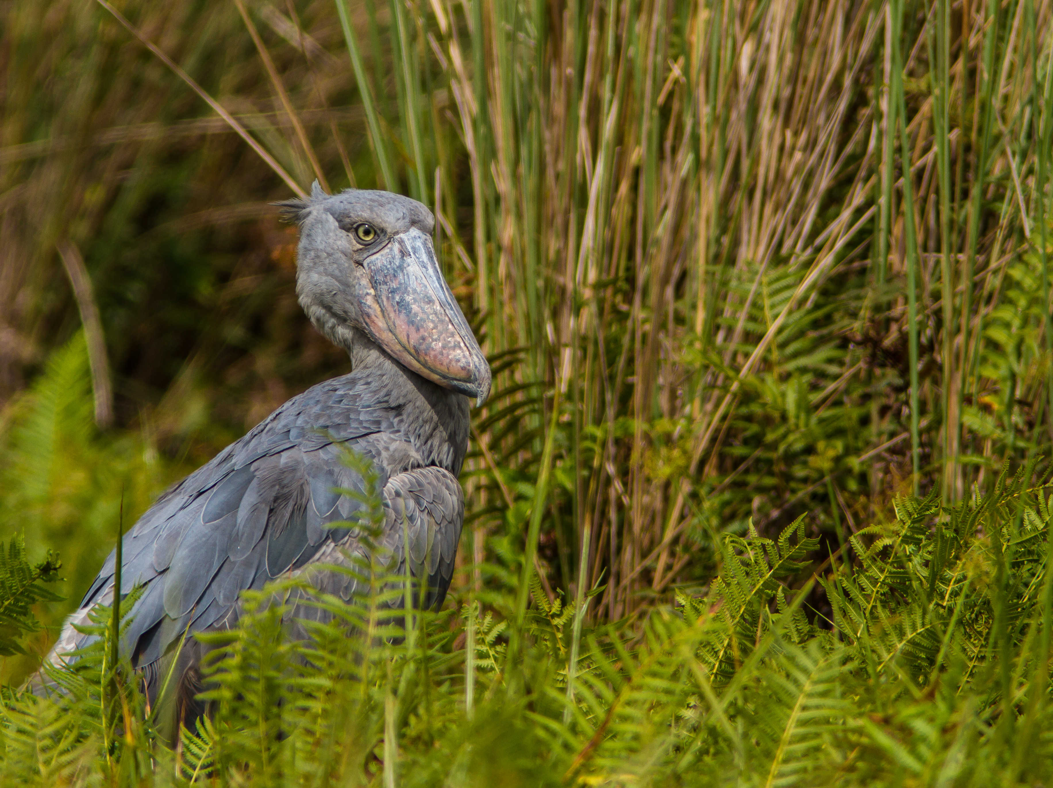
Sanctuaries
Community Conservation Areas
Ramsar Sites
World Heritage Sites
East-Asian Australasian Flyway Network Sites
Western/Central Asian Flyway Site Network
WHSRN sites
Important Bird and Biodiversity Areas (IBA)
Privately owned areas
Unprotected areas
National Parks
Industrial Wetlands
What sites are monitored in the IWC?
© Sergey Dereliev, www.dereliev-photography.com
Notes:
The IWC includes an incredible diversity of wetland types
Sites range from remote areas visited by few people, to urban wetlands near major cities. Each contributes a piece to the global picture of how waterbirds and wetlands are changing. This breadth gives the IWC unique value: it’s the only global dataset connecting local wetlands to international conservation priorities.

Slide 9
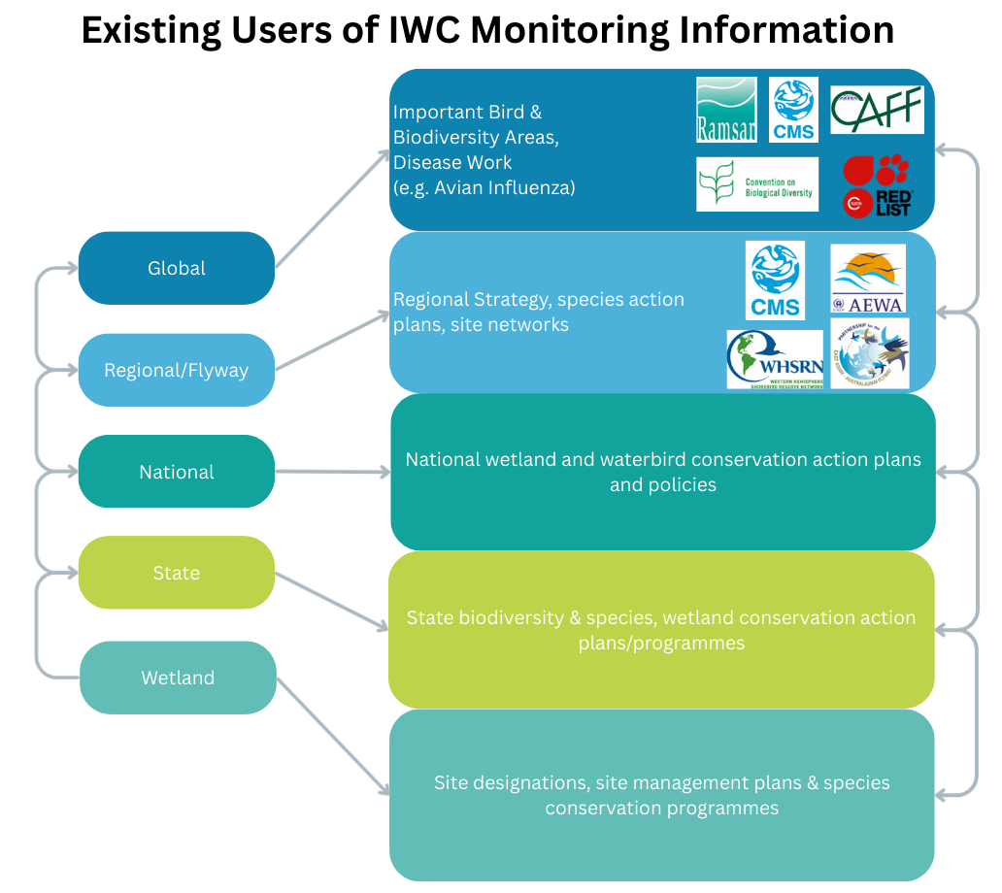
Notes:
So what is the impact of the counts? The IWC connects citizen science directly to global and regional conservation policy and action, More than 956 Ramsar sites – covering almost 1.5 million square kilometers, have been designated based on 1% population thresholds, many based on IWC data. 2,721 European Union Special protected Areas, covering 418,000 km2 have been designated based on IWC data, an area larger than Germany, and it is a core data resource for the 160 sites forming the site network of the East Asian-Australasian Flyway Partnership.
It has also been vital in guiding efforts to restore and manage species. IUCN Red List assessments for many waterbird species are informed by the IWC and different bodies use the data as the basis for Action Plans, and international Single Species Action and Management Plans under the African-Eurasian Waterbird Agreement (AEWA).
Since 2005, IWC data has also contributed to global research on Highly Pathogenic Avian Influenza, working with FAO, CMS, WHO and others.
This graphic aims to emphasize the various levels at which IWC data can work, from local wetlands to global initiatives.

Slide 10
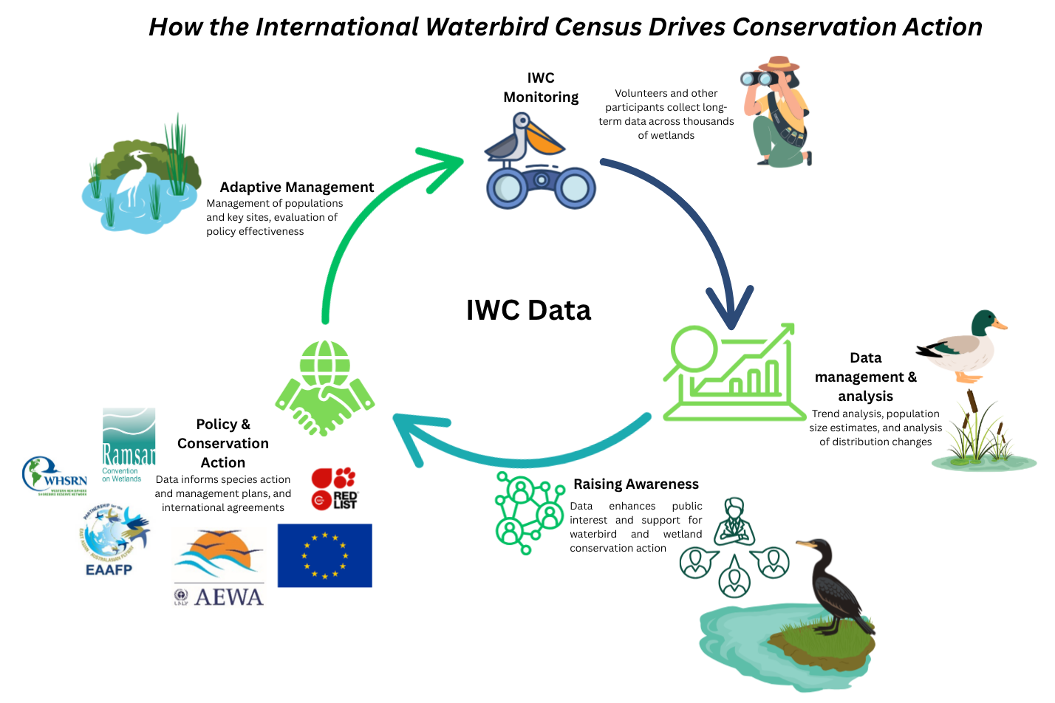
Notes:
Interestingly, Monitoring through the IWC also provides a feedback mechanism, helping adaptive management of flyway site networks — detecting issues, and then guiding solutions. This shows how the IWC supports waterbird conservation across the full cycle of adaptive management.
Chris – maybe check with Tom and Szabolc s but I would say you can add a lot of organisations against Policy and Conservation action including ourselves, BirdLife WWT etc etc. It might clog the graphic to do that but worth mentioning

Slide 11
Policy & Advocacy
IWC underpins:
Site Prioritisation & Protection (Ramsar sites, AEWA Critical Sites, EAAFP Network Sites, WHSRN Network Sites, Key Biodiversity Areas, EU Special Protected Areas)
National Reporting and Conservation Obligations
Legal Frameworks (EU Birds Directive, AEWA)
Action Plans
(National Biodiversity Strategies and Action Plans (NBSAPs), Nationally Determined Contributions (NDCs), and National Adaptation Plans (NAPs)
Global biodiversity targets (GBF, SDGs)
Notes:
The IWC’s data feed directly into major international frameworks The IWC underpins site prioritisation & protection, By providing robust, long-term data, the IWC helps governments and partners set conservation priorities and measure progress — making it one of Wetlands International’s strongest evidence-based advocacy tools.
The strategy aims to embed wetlands—including those critical for waterbirds—into National Biodiversity Strategies and Action Plans (NBSAPs), Nationally Determined Contributions (NDCs), and National Adaptation Plans (NAPs). SN> You can highlight the IWC’s contribution to the flyway instruments (AEWA, EAAFP), the Ramsar Convention, and the EU Birds Directive.

Slide 12
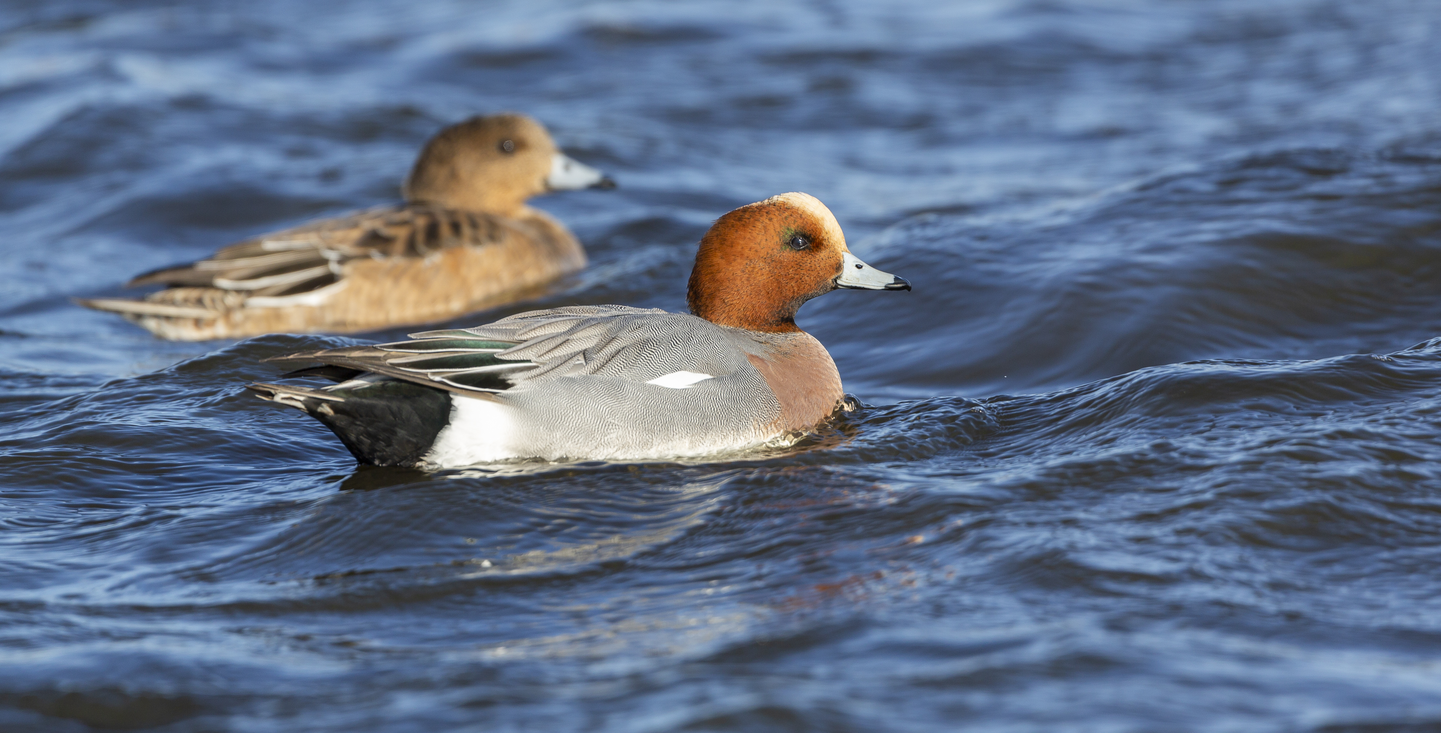
Case Study: Wigeon Early Warning System
© Sergey Dereliev, www.dereliev-photography.com
Eurasian Wigeon: important hunted species.
Boreal/Arctic breeder, winters in temperate wetlands
IWC showed sudden population decline in early 2000s.
Initially thought to be short-stopping due to milder winters.
Research confirmed real decline linked to breeding-ground vegetation loss (Equisetum).
Triggered targeted habitat management + adaptive harvest plan in EU.
Notes:
Onto some examples highlighting the value of IWC data. The Eurasian Wigeon is a boreal and arctic breeding species that winters in large numbers in temperate wetlands. It is also an important hunted species.
In the early 2000s, IWC counts showed a sudden decline in numbers.
At first, this was dismissed as short-stopping – the concept that milder winters meant that birds stayed closer to their breeding grounds.
However, further research revealed this was a real population decline, linked to low productivity and the loss of shoreline vegetation, such as horsetail, in their breeding grounds.
Independent breeding surveys confirmed these declines. This early warning from the IWC triggered targeted habitat management and the development of an adaptive harvest management plan in the EU.

Slide 13
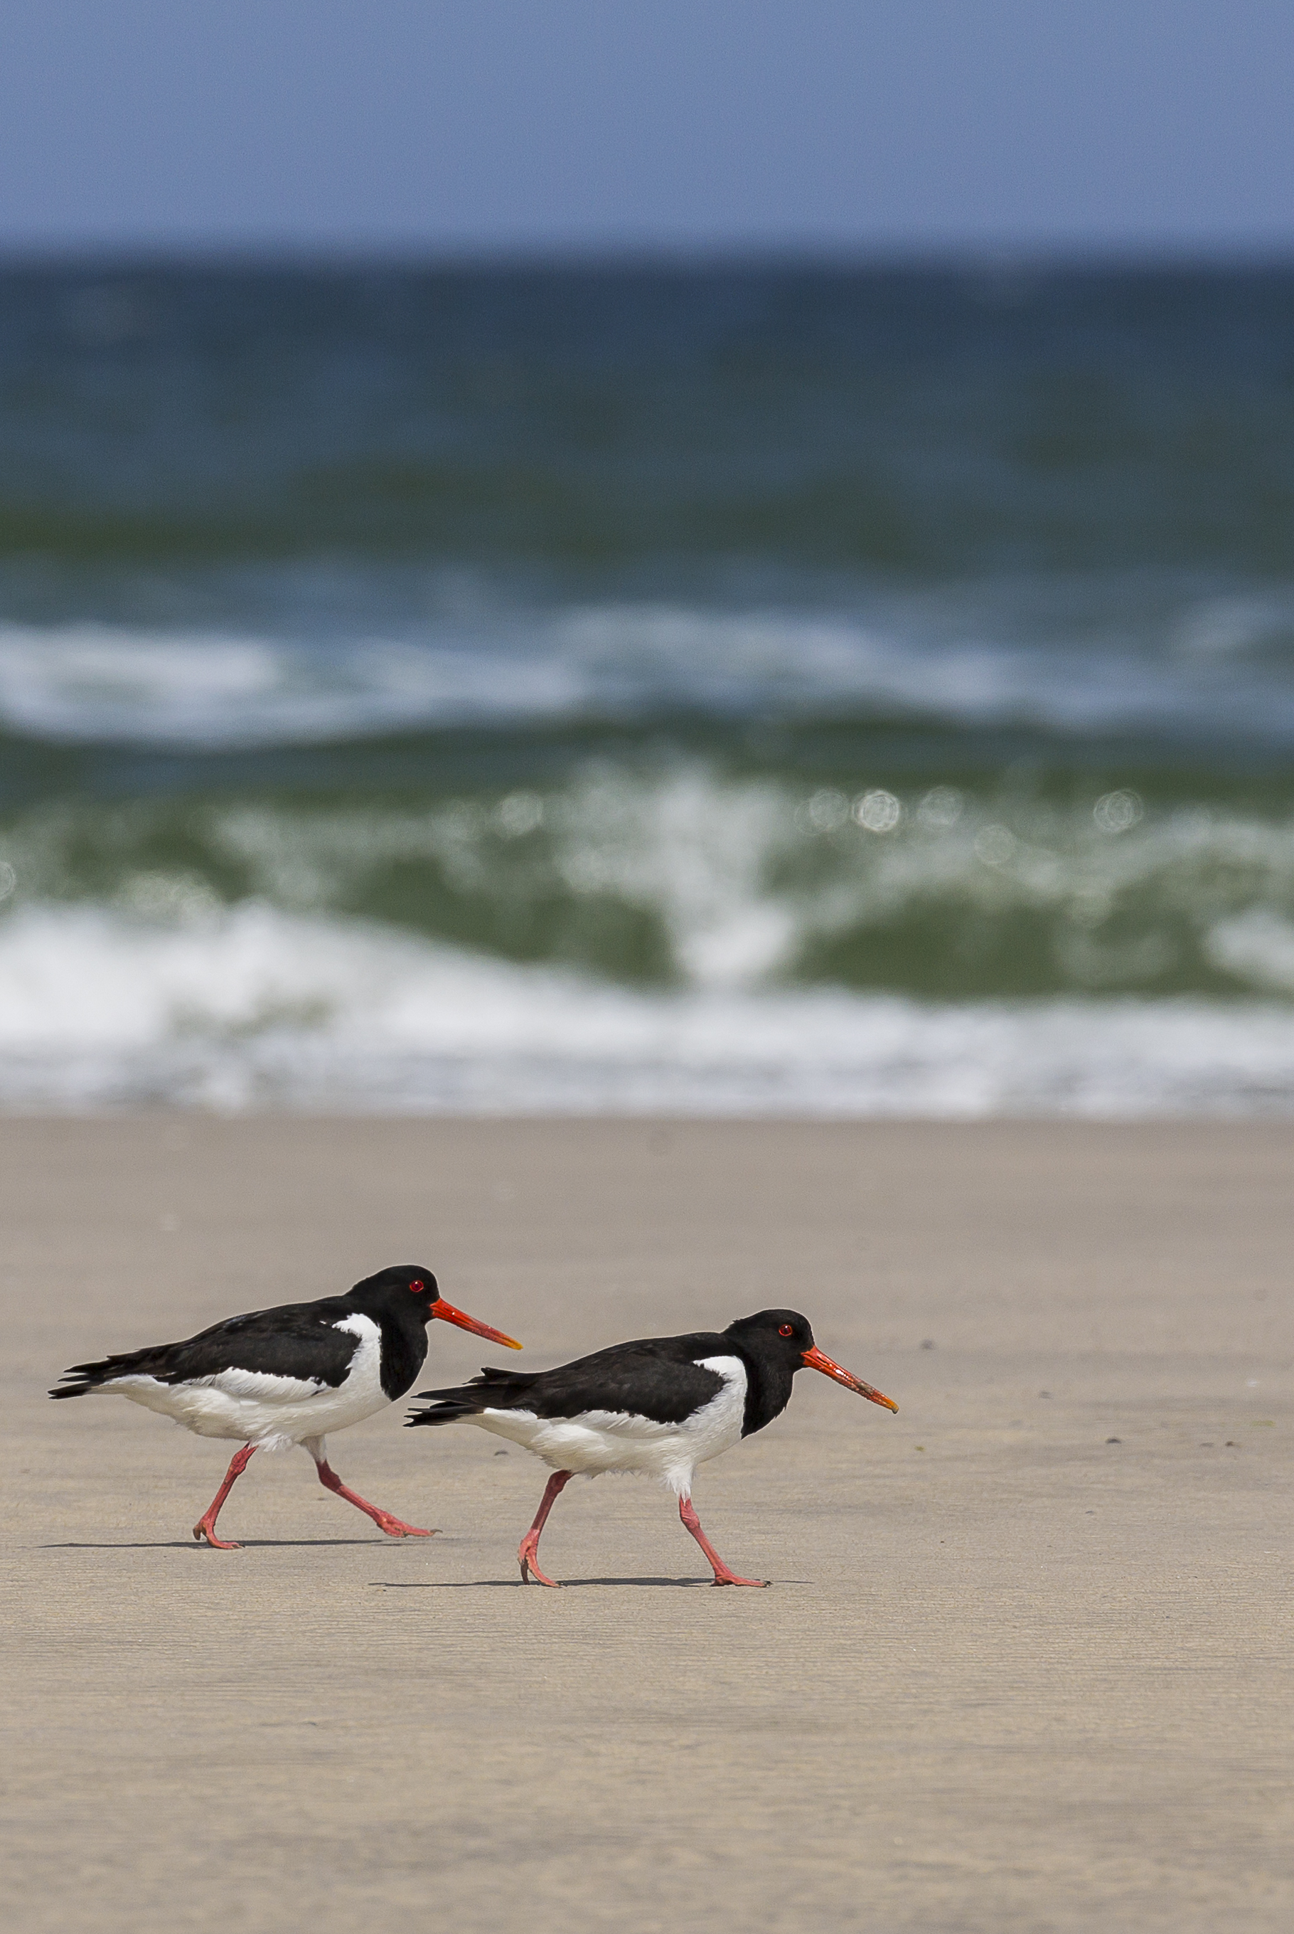
Case Study: Adapting protected area networks to the changing climate
© Sergey Dereliev, www.dereliev-photography.com
IWC can help detect the impact of climate change in wintering ranges of waterbirds
East Atlantic Flyway: fewer Curlews & Oystercatchers reaching Africa; many waders now winter ~100km closer to breeding grounds
Global trends: Ranges track temperature in temperate zones, precipitation in tropics
Models predict significant range shifts by 2050: major northeastward shift in Europe (Baltic to southern Russia); Africa ranges increasingly fragmented
Protected areas accommodate some changes, but unprotected wetlands increasingly used by waterbirds → need dynamic site networks
Notes:
The IWC has been essential in demonstrating the impact of climate change on waterbird populations, and in guiding governments and treaties on how to respond.
For example, Eurasian Curlews and European Oystercatchers are migrating to Africa in smaller numbers, while many waders that used to winter in Europe are now staying about 100 kilometres closer to their breeding areas. Species distribution models, partly reliant on IWC data, predict that by 2050 wintering ranges in Europe will significantly shift further northeast, opening up suitable areas for waterbirds from the Baltic to southern Russia. At the same time, African waterbird ranges are expected to become increasingly fragmented.
Importantly, IWC data also demonstrates that protected areas can effectively accommodate changes in wintering distributions, but waterbirds are increasingly using unprotected wetlands along the leading northern edge of their wintering range. This highlights the need for a more dynamic approach to protected area management.

Slide 14
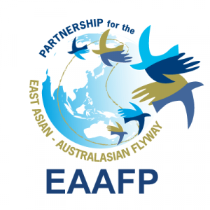

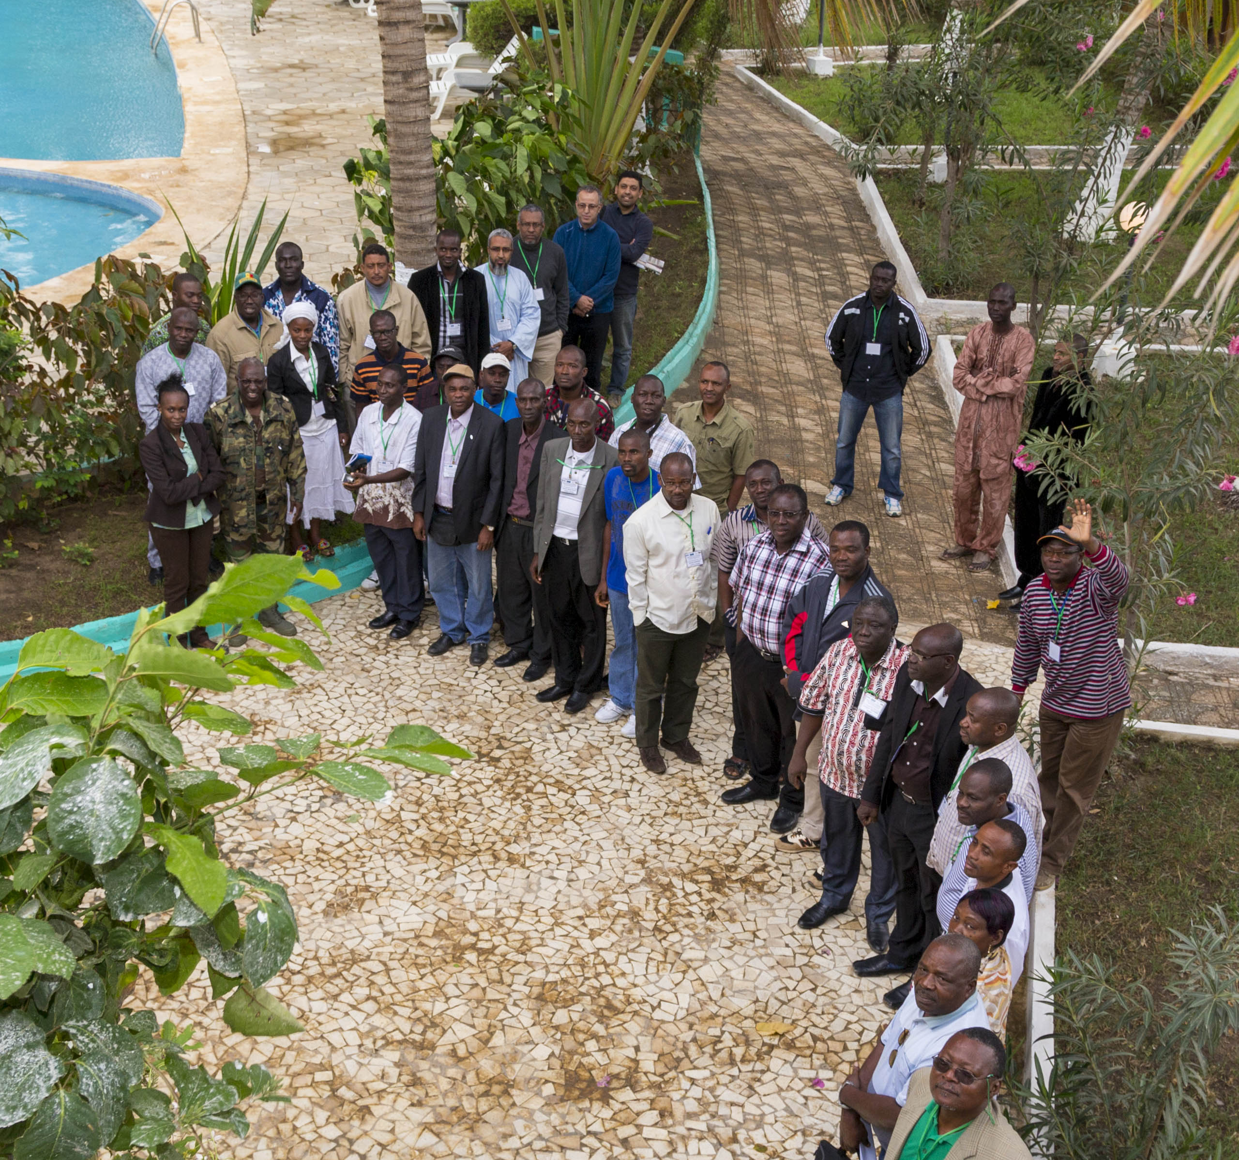
Case Study: Prioritising Sites
IWC identifies sites for Ramsar, EAAFP, AEWA, WHSRN.
Encourages local partners to monitor sites annually.
Recent: IWC informed Asian Development Bank’s USD 3B Regional Flyway Initiative.
50 sites in East & SE Asia: management planning, nature-based solutions, benefiting waterbirds and biodiversity.
Photo by Szabolcs Nagy
Notes:
Another role of the IWC is prioritizing key sites where conservation should focus. It has long been the basis for Ramsar sites and flyway networks such as the EAAFP, AEWA’s Critical Site Network, and WHSRN. More recently, IWC data has helped development agencies identify where to invest in management. For example, the Asian Development Bank’s Regional Flyway Initiative is using IWC data to guide investments in 50 sites across East and Southeast Asia. These investments will improve site management, apply nature-based solutions, and benefit not just migratory waterbirds but also local communities and other biodiversity.

Slide 15
IWC Supports our Fundraising Efforts
East Atlantic Flyway Monitoring
Wadden Sea Flyway Initiative
CREAF IKI project
DOB Ecology
Asian Development Bank Regional Flyway Initiative
GEF (Wings over Wetlands)
National Contributions
Notes:
The International Waterbird Census costs us roughly €110,000 per year to coordinate globally. That’s a small investment when we look at what it enables.
Over the years, IWC data, methods, and partnerships have helped secure major international projects and funding for Wetlands International and our partners — easily over a million euros annually, and in many years much more.
And finally, many national governments contribute directly to IWC activities — using the results for Ramsar reporting, biodiversity monitoring, and policy development.
So while the IWC itself is a modest, long-term programme, it acts as a catalyst — helping unlock millions in conservation investments globally. It’s one of the most cost-effective and high-impact initiatives within the Wetlands International portfolio.
For example, the East Atlantic Flyway Monitoring and the Wadden Sea Flyway Initiative both rely heavily on IWC data and networks to track migration and guide management across Africa and Europe. The CREAF IKI project and DOB Ecology programmes also use IWC results to prioritise wetlands for restoration and protection. On the development side, the Asian Development Bank’s Regional Flyway Initiative, a €3 billion investment, was directly shaped by IWC information on key sites and population trends. Similarly, the GEF “Wings over Wetlands” programme used IWC data as a basis for site prioritisation and management planning across multiple flyways.

Slide 16
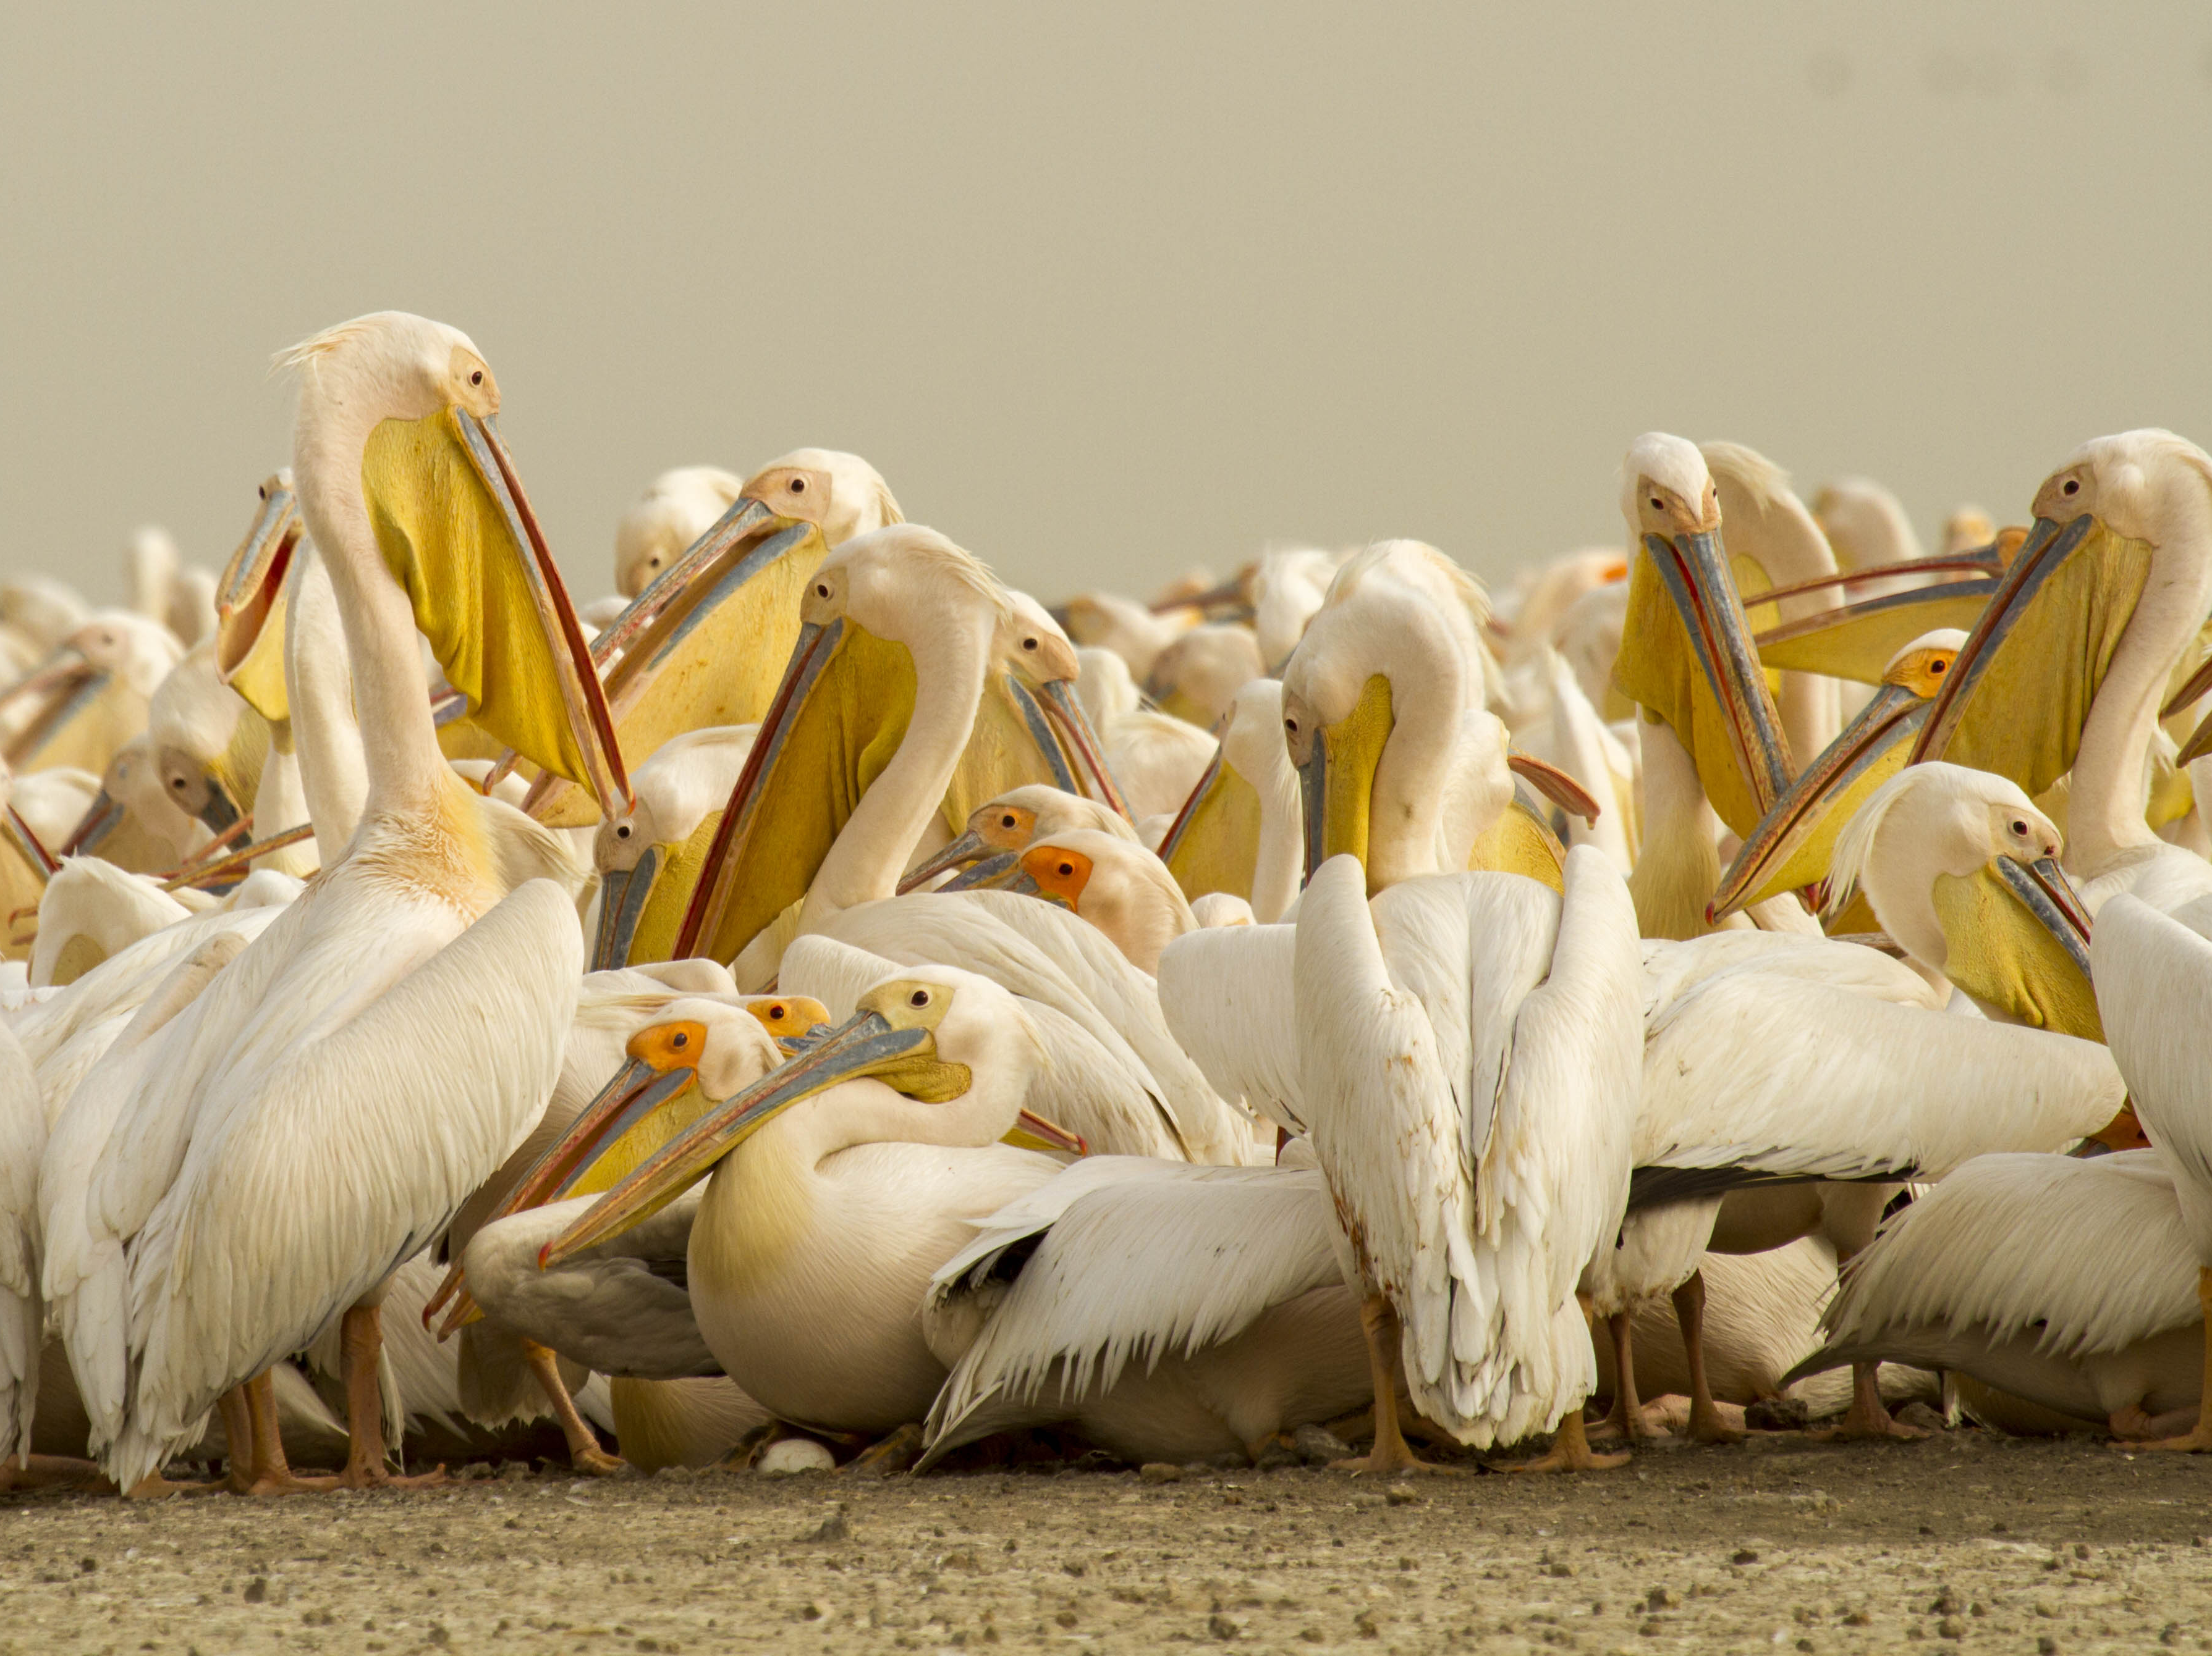
Possibilities for Future Fundraising
Strategic finance: nature-related bonds, biorights, wetland-positive investments
Potential for fundraising from Corporate, Philanthropic Organisations, Development Banks in all Flyways
Photo by Szabolcs Nagy
Notes:
Linking to our new strategy…
Global initiative

Slide 17
IWC A Strategic Asset for WI
Evidence base for WI’s goals and strategy
Tool for advocacy & visibility
Platform for partnerships & coalitions
Channel for community engagement
Let’s celebrate the 60th Count!
Notes:
The IWC is more than a programme — it’s a strategic asset for Wetlands International. It connects science, advocacy, and fundraising while strengthening our identity as an authority on wetlands and migratory birds. It also embodies the WI model: combining data, partnerships, and people to achieve change from local to global levels.

Slide 18
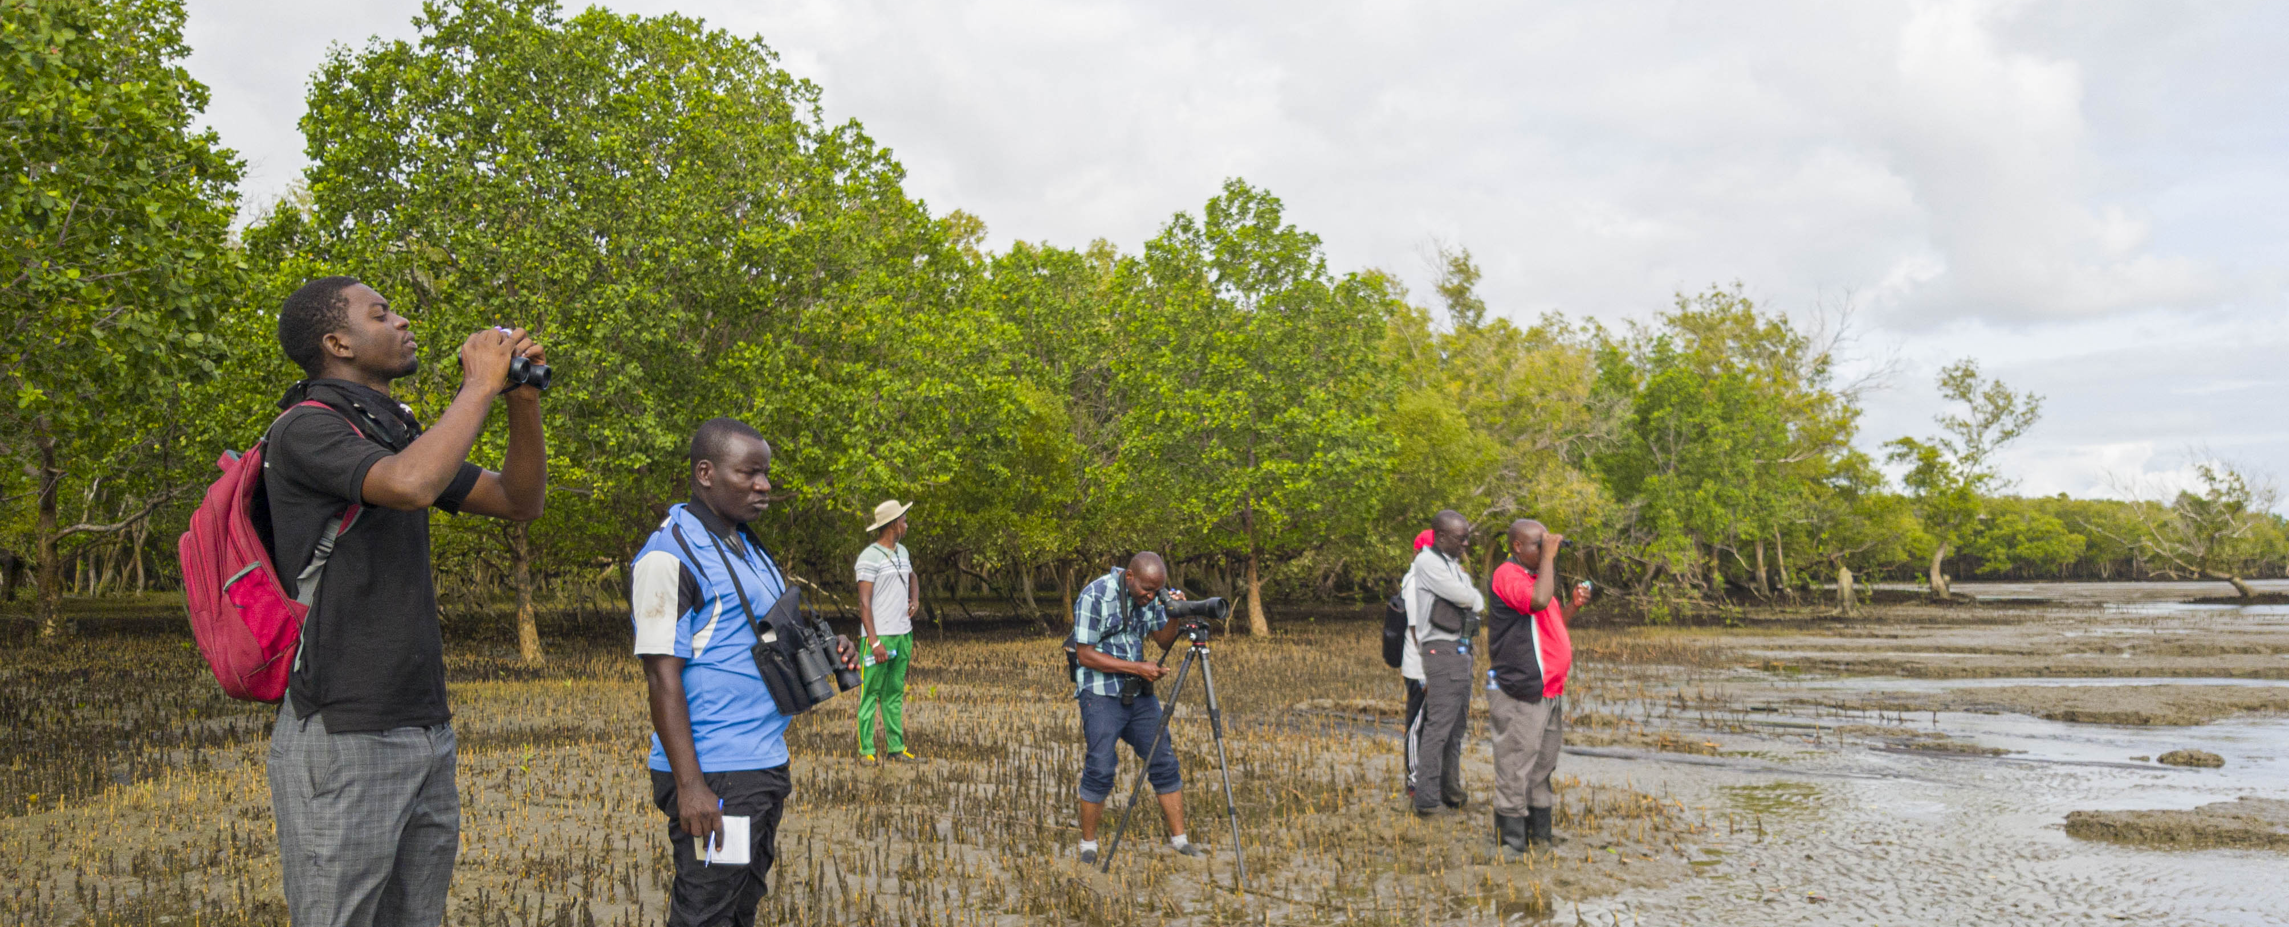
Call to Action: 60th Edition IWC
Photo by Szabolcs Nagy
Join & Promote the counts in your country & region
Support monitoring efforts at key sites
Use IWC as an indicator in your projects and strategies
Sharing stories of local to global waterbird monitoring
Notes:
As we approach the 60th IWC count this January, this is an ideal moment to engage your offices and networks. Encourage participation in national and regional counts, promote the IWC in your communications, and use it as an indicator in projects and proposals. Every additional observer and site strengthens the network.

Slide 19
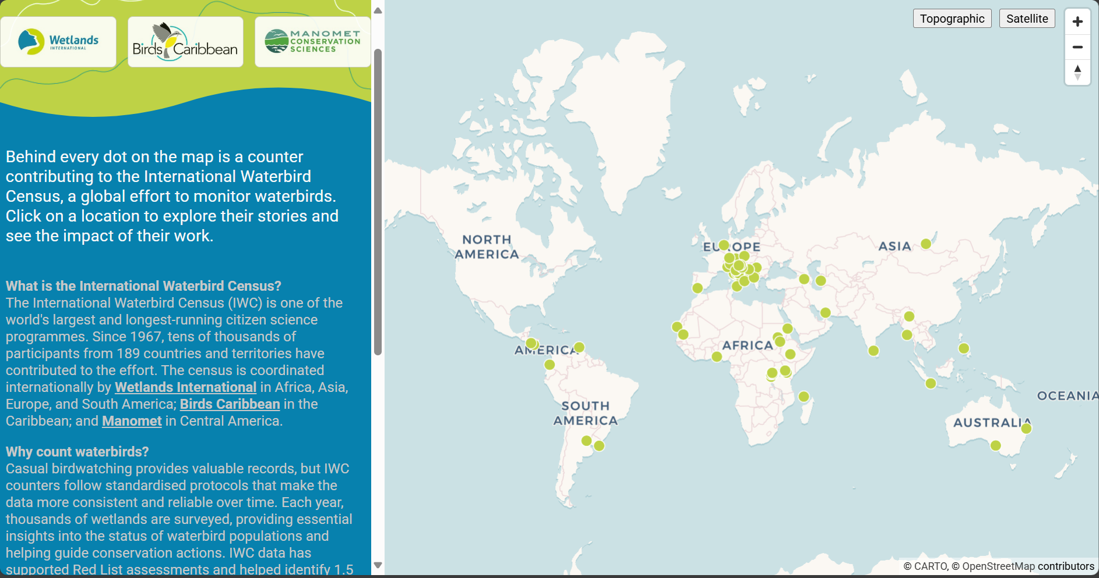
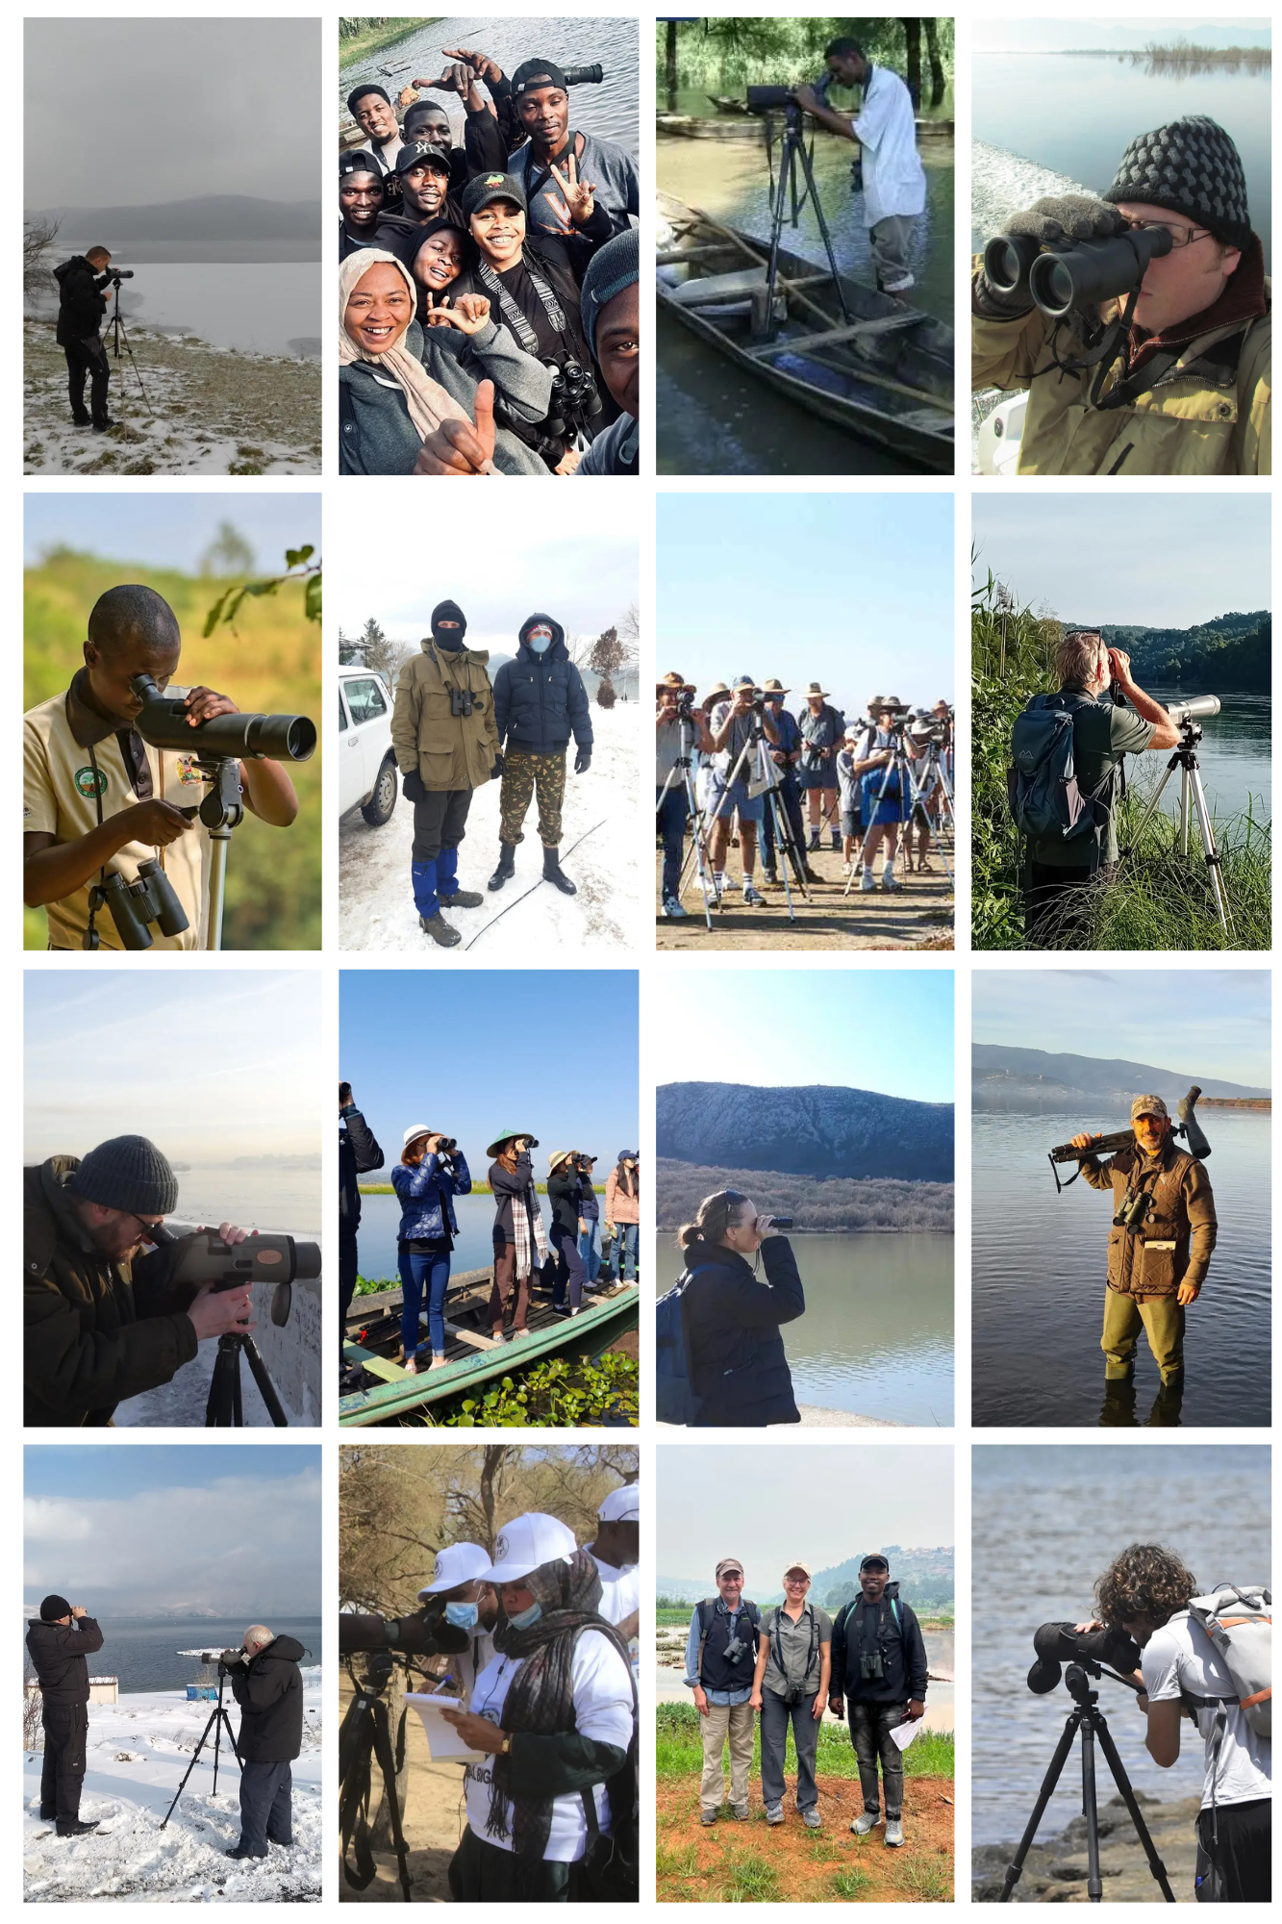
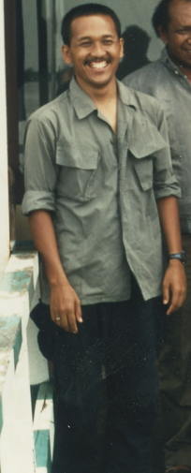
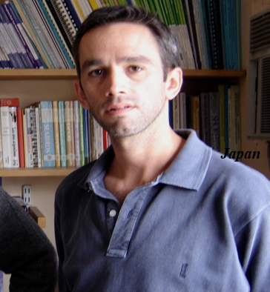
Promoting IWC Stories
IWC counter postcards
Network WI can tap into
On the ground experts for WI to utilise
Photo credit - Steeve Mathieu - GEPOMAY, Igor Tupitsyn, Laban Kayitete, F. Sibomana, Richard Kipngeno, Mohamed Elmekki Ali Elbadawi Hussien, Mohamed Abd El Hafeez, Mamikon Ghasabyan, Slave Nakev, Mariagrazia Citterio, Slobodan Marković, Paolo Bocchini, Indawgyi Wildlife Sanctuary, Queensland Wader Study Group (QWSG), Andrej Vizi, Siniša Veselić
Yus Rusila Nor – Head of the Indonesia office and former National Coordinator
Daniel Blanco – Head of the Latin America and Caribbean office in Argentina and is the regional coordiator for the Neotropical Waterbird Census:
Notes:
We’re also encouraging offices to share local stories — highlighting the human side of the IWC. Take a look at our postcards website. For example, Yus Rusila Nor in Indonesia and Daniel Blanco in Argentina both bridge roles as Heads of Office and former coordinators. Their experiences show how data collection builds community, visibility, and pride. Sharing these stories helps strengthen internal cohesion and public awareness of Wetlands International’s impact.

Slide 20
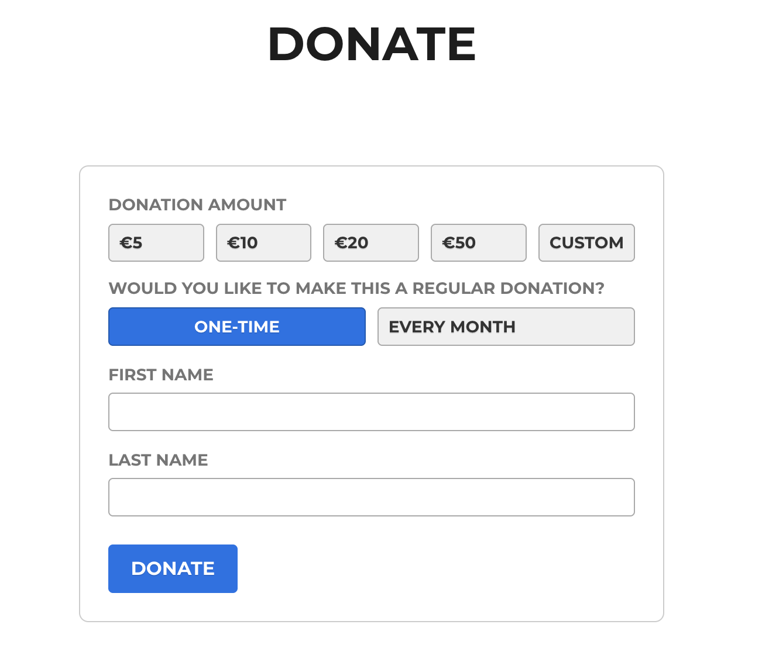
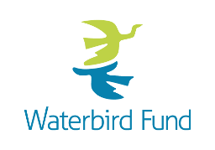
Waterbird Fund
The Waterbird Fund aims to:
Enable our local partners to conduct vital national monitoring programmes.
Improve monitoring of waterbirds at key sites which are seldom counted because of limited resources.
Guide science-based conservation and sustainable use of waterbirds.
What we are doing:
East Africa West Asia with support from LEICA optics
Exploring options in Asia (including Afghanistan)
What could you do?
Promote the Waterbird Fund in your countries and regions as a mechanism to support monitoring
Corporates, Governments, Individuals with a particular interest in waterbirds and wetlands
https://waterbird.fund
Notes:
To sustain the IWC, we have the Waterbird Fund — a fundraising campaign to support continuous monitoring globally as best we can. It enables local partners to continue vital national programmes, improves coverage of key sites, and encourages expansion of the counts Offices can promote the Fund to governments, corporates, or individuals interested in wetlands. It’s a simple yet effective way to ensure monitoring remains strong in the decades ahead.

Slide 21
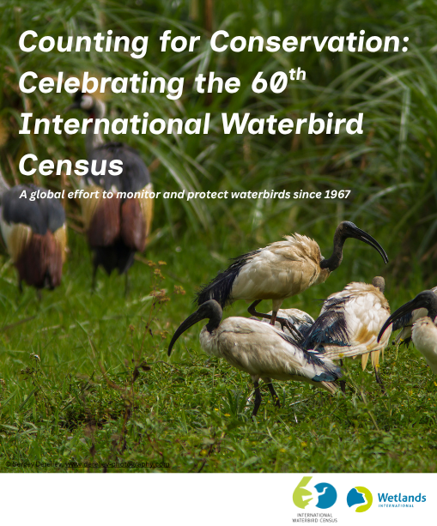
IWC60 Brochure
Request from our members
Translate into languages
Covers:
60 years of the International Waterbird Census
What We’ve Learned: 60 years of Trends
the Beginning of IWC
Global Expansion
Conservation Impact
AEWA Box, CWC Box
Case Studies
Call-to-Action
Notes:
We’ve also developed a 60th-anniversary brochure that summarises six decades of IWC achievements, lessons, and global trends. It will be available for translation and distribution through our network, including at upcoming events like AEWA and EAAFP MOP. This is an excellent outreach tool — both for raising awareness and supporting your fundraising or communications efforts. We can provide digital versions to offices and encourage them to translate this brochure into their local languages.
Chris – so this is something that our colleagues can receive and translate to loc al language? Do they know this already? When will it be available?

Slide 22
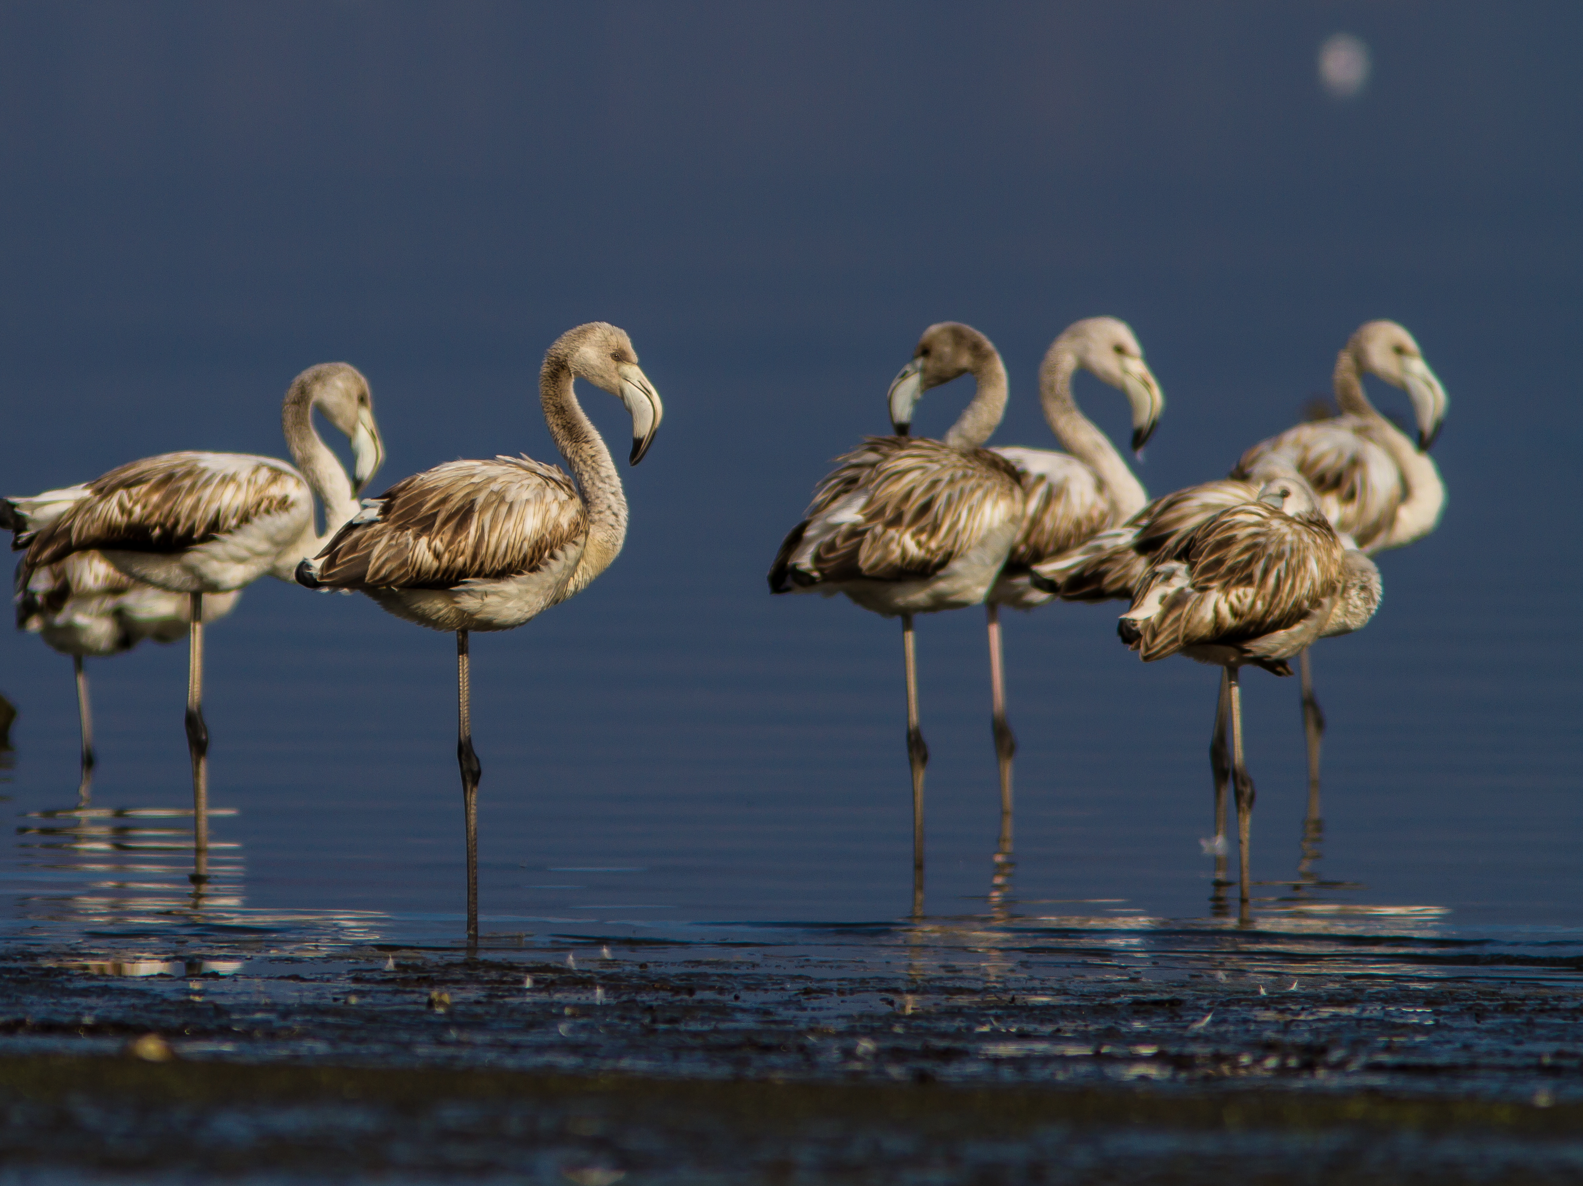
Thank you for your attention!
Any Questions?
Luca Guitink
Luca.Guitink@wetlands.org

